Slide 1
7
Arrays and Vectors

Slide 2
Now go, write it before them in a table, and note it in a book.
  Isaiah 30:8
To go beyond is as wrong as to fall short.
  Confucius
Begin at the beginning... and go on till you come to the end: then stop.
  Lewis Carroll

Slide 3
OBJECTIVES
In this chapter you’ll learn:
To use the array data structure to represent a set of related data items.
To use arrays to store, sort and search lists and tables of values.
To declare arrays, initialize arrays and refer to the individual elements of arrays.
To pass arrays to functions.
Basic searching and sorting techniques.
To declare and manipulate multidimensional arrays.
To use C++ Standard Library class template vector.

Slide 4
7.1 Introduction
7.2 Arrays
7.3 Declaring Arrays
7.4 Examples Using Arrays
7.5 Passing Arrays to Functions
7.6 Case Study: Class GradeBook Using an Array to Store Grades
7.7 Searching Arrays with Linear Search
7.8 Sorting Arrays with Insertion Sort
7.9 Multidimensional Arrays
7.10 Case Study: Class GradeBook Using a Two-Dimensional Array
7.11 Introduction to C++ Standard Library Class Template vector
7.12 (Optional) Software Engineering Case Study: Collaboration Among Objects in the ATM System
7.13 Wrap-Up

Slide 5
7.1 Introduction
Arrays
  Data structures containing related data items of same type
  Always remain the same size once created
    Are “static” entities
  Character arrays can also represent strings
  C-style pointer-based arrays vs. vectors (object-based)
    Vectors are safer and more versatile

Slide 6
7.2 Arrays
Array
  Consecutive group of memory locations
    All of which have the same type
  Index
    Position number used to refer to a specific location/element
    Also called subscript
    Place in square brackets
      Must be positive integer or integer expression
    First element has index zero
    Example (assume a = 5 and b = 6)
      c[ a + b ] += 2;
        Adds 2 to array element c[ 11 ]

Slide 7
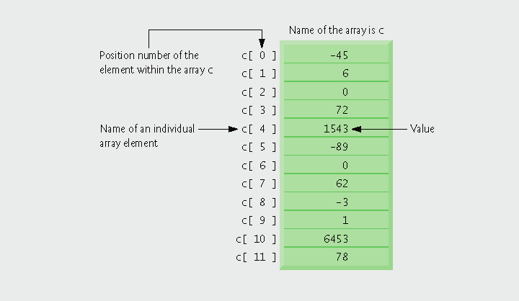
Fig.7.1 | Array of 12 elements

Slide 8
7.2 Arrays (Cont.)
Examine array c in Fig. 7.1
  c is the array name
  c has 12 elements ( c[0], c[1], … c[11] )
    The value of c[0] is –45
Brackets used to enclose an array subscript are actually an operator in C++

Slide 9
Common Programming Error 7.1
It is important to note the difference between the “seventh element of the array” and “array element 7.” Array subscripts begin at 0, so the “seventh element of the array” has a subscript of 6, while “array element 7” has a subscript of 7 and is actually the eighth element of the array. Unfortunately, this distinction frequently is a source of off-by-one errors. To avoid such errors, we refer to specific array elements explicitly by their array name and subscript number (e.g., c[ 6 ] or c[ 7 ]).

Slide 10
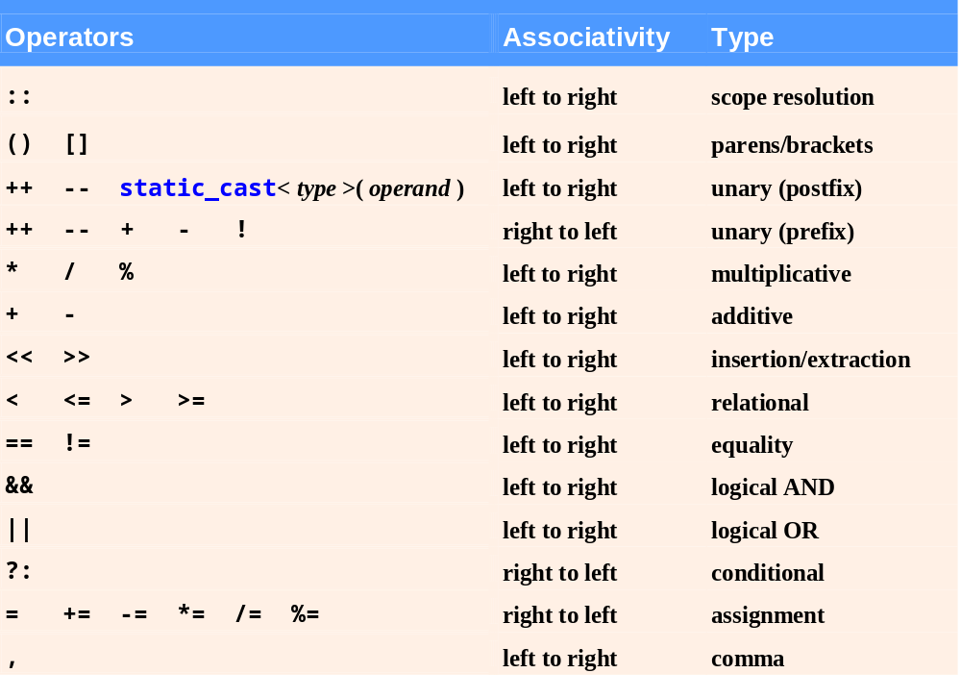
Fig.7.2 | Operator precedence and associativity.

Slide 11
7.3 Declaring Arrays
Declaring an array
  Arrays occupy space in memory
  Programmer specifies type and number of elements
    Example
      int c[ 12 ];
        c is an array of 12 ints
  Array’s size must be an integer constant greater than zero
  Arrays can be declared to contain values of any non-reference data type
  Multiple arrays of the same type can be declared in a single declaration
    Use a comma-separated list of names and sizes

Slide 12
Good Programming Practice 7.1
We prefer to declare one array per declaration for readability, modifiability and ease of commenting.

Slide 13
7.4 Examples Using Arrays
Using a loop to initialize the array’s elements
  Declare array, specify number of elements
  Use repetition statement to loop for each element
    Use body of repetition statement to initialize each individual array element

Slide 14
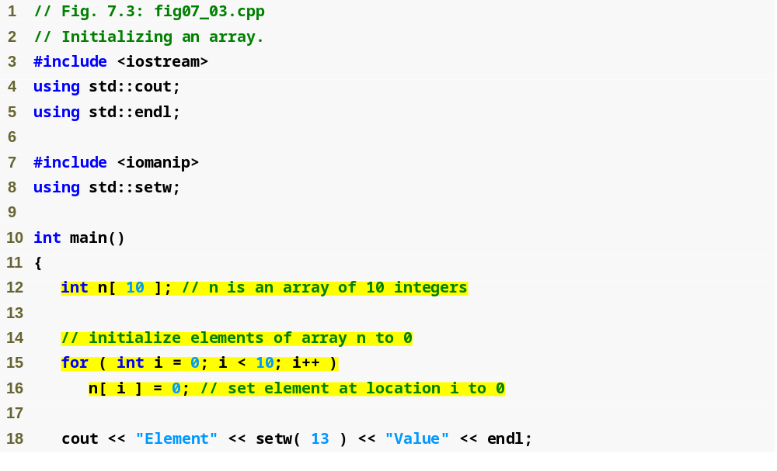
Outline
fig07_03.cpp
(1 of 2)
Declare n as an array of ints with 10 elements
Each int initialized is to 0

Slide 15
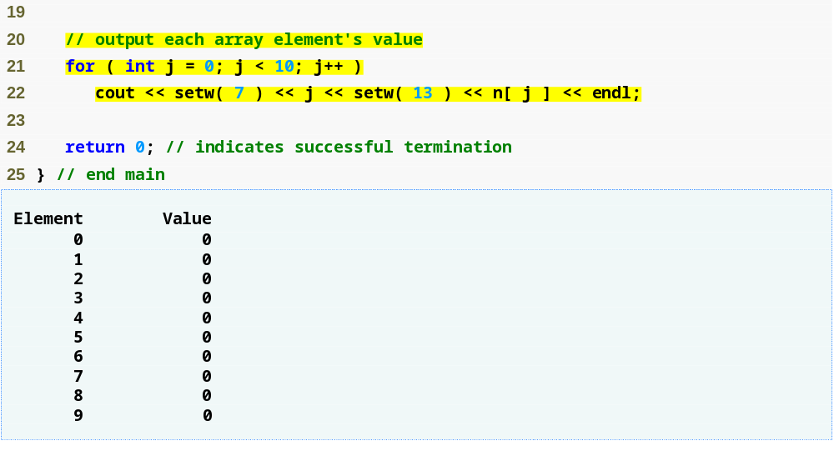
Outline
fig07_03.cpp
(2 of 2)
n[ j ] returns int associated with index j in array n
Each int has been initialized to 0

Slide 16
7.4 Examples Using Arrays (Cont.)
Initializing an array in a declaration with an initializer list
  Initializer list
    Items enclosed in braces ({})
    Items in list separated by commas
    Example
      int n[] = { 10, 20, 30, 40, 50 };
        Because array size is omitted in the declaration, the compiler determines the size of the array based on the size of the initializer list
        Creates a five-element array
        Index values are 0, 1, 2, 3, 4
        Initialized to values 10, 20, 30, 40, 50, respectively

Slide 17
7.4 Examples Using Arrays (Cont.)
Initializing an array in a declaration with an initializer list (Cont.)
  If fewer initializers than elements in the array
    Remaining elements are initialized to zero
    Example
      int n[ 10 ] = { 0 };
        Explicitly initializes first element to zero
        Implicitly initializes remaining nine elements to zero
  If more initializers than elements in the array
    Compilation error

Slide 18
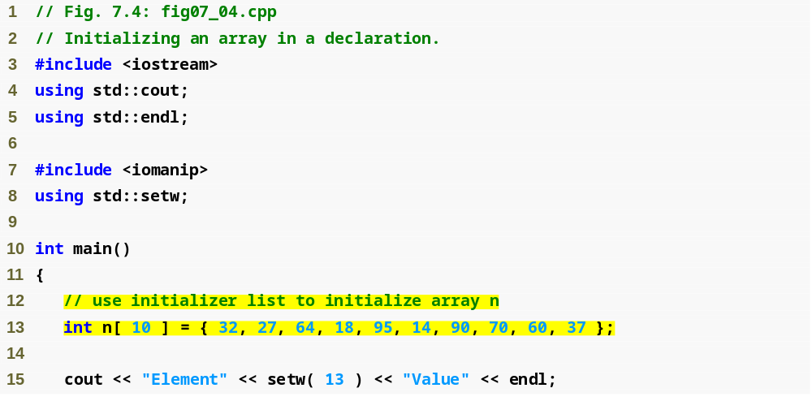
Outline
fig07_04.cpp
(1 of 2)
Declare n as an array of ints
Compiler uses initializer list to initialize array

Slide 19
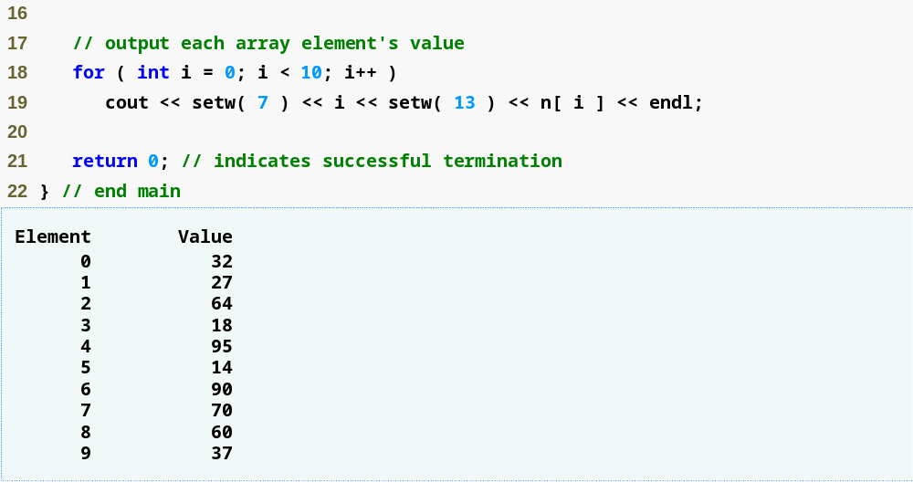
Outline
fig07_04.cpp
(2 of 2)

Slide 20
Common Programming Error 7.2
Providing more initializers in an array initializer list than there are elements in the array is a compilation error.

Slide 21
Common Programming Error 7.3
Forgetting to initialize the elements of an array whose elements should be initialized is a logic error.

Slide 22
7.4 Examples Using Arrays (Cont.)
Specifying an array’s size with a constant variable and setting array elements with calculations
  Initialize elements of 10-element array to even integers
  Use repetition statement that calculates value for current element, initializes array element using calculated value

Slide 23
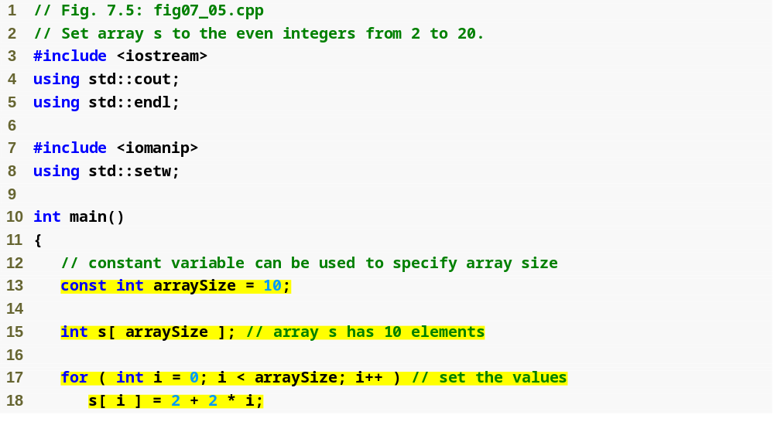
Outline
fig07_05.cpp
(1 of 2)
Declare constant variable arraySize using the const keyword
Declare array that contains 10 ints
Use array index to assign element’s value

Slide 24
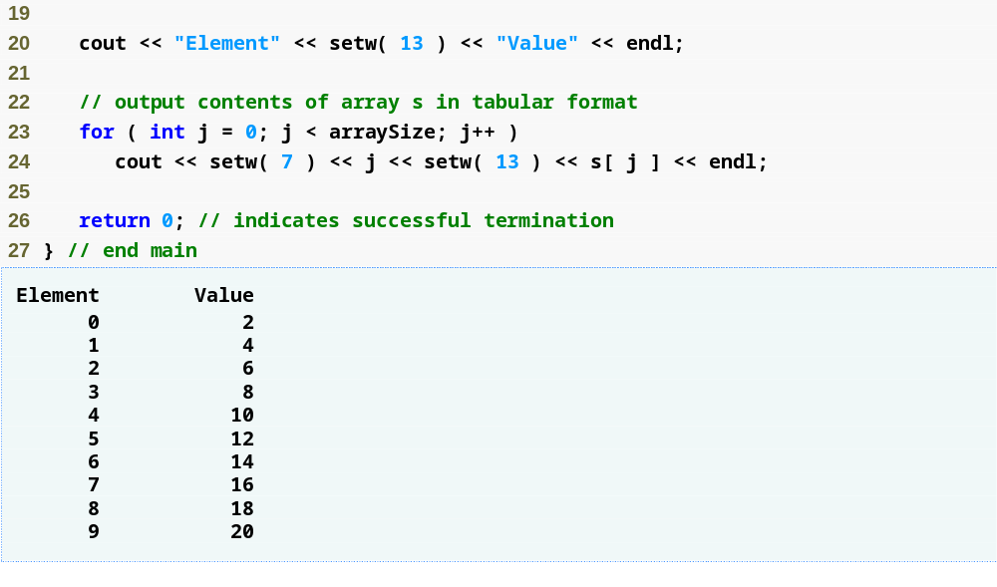
Outline
fig07_05.cpp
(2 of 2)

Slide 25
7.4 Examples Using Arrays (Cont.)
Constant variables
  Declared using the const qualifier
  Also called name constants or read-only variables
  Must be initialized with a constant expression when they are declared and cannot be modified thereafter
  Can be placed anywhere a constant expression is expected
  Using constant variables to specify array sizes makes programs more scalable and eliminates “magic numbers”

Slide 26
Common Programming Error 7.4
Not assigning a value to a constant variable when it is declared is a compilation error.

Slide 27
Common Programming Error 7.5
Assigning a value to a constant variable in an executable statement is a compilation error.

Slide 28
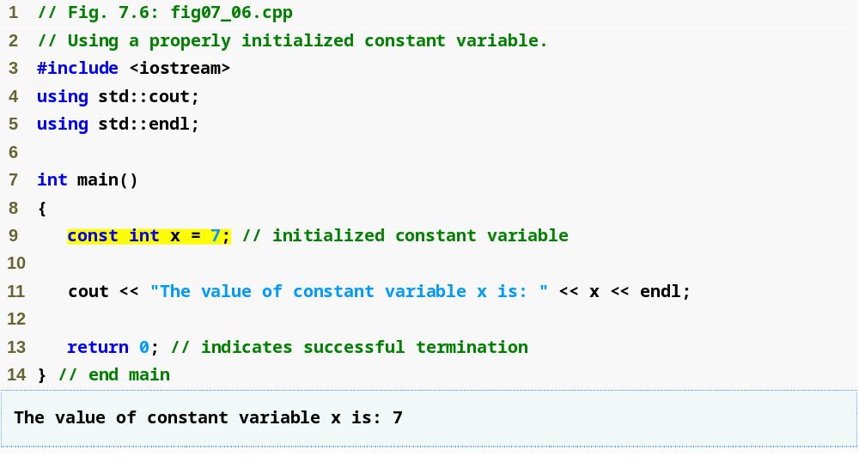
Outline
fig07_06.cpp
(1 of 1)
Declaring constant value

Slide 29
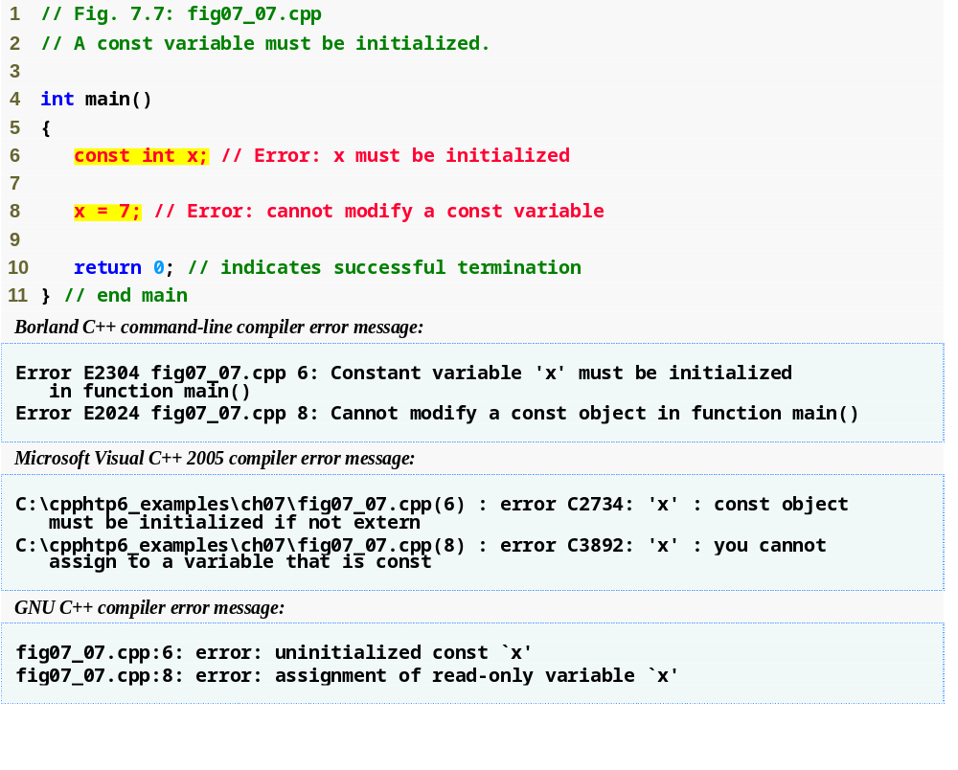
Outline
Must initialize a constant at the time of declaration
Cannot modify a constant
fig07_07.cpp
(1 of 1)
Error messages differ based on the compiler

Slide 30
Common Programming Error 7.6
Only constants can be used to declare the size of automatic and static arrays. Not using a constant for this purpose is a compilation error.

Slide 31
Software Engineering Observation 7.1
Defining the size of each array as a constant variable instead of a literal constant can make programs more scalable.

Slide 32
Good Programming Practice 7.2
Defining the size of an array as a constant variable instead of a literal constant makes programs clearer. This technique eliminates so-called magic numbers. For example, repeatedly mentioning the size 10 in array-processing code for a 10-element array gives the number 10 an artificial significance and can unfortunately confuse the reader when the program includes other 10s that have nothing to do with the array size.

Slide 33
7.4 Examples Using Arrays (Cont.)
Summing the elements of an array
  Array elements can represent a series of values
    We can sum these values
    Use repetition statement to loop through each element
      Add element value to a total

Slide 34
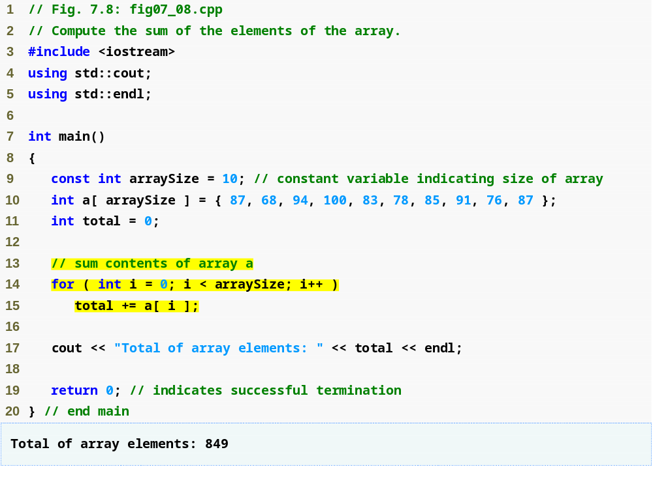
Outline
fig07_08.cpp
(1 of 1)
Declare array with initializer list
Sum all array values

Slide 35
7.4 Examples Using Arrays (Cont.)
Using bar charts to display array data graphically
  Present data in graphical manner
    E.g., bar chart
  Examine the distribution of grades
  Nested for statement used to output bars

Slide 36
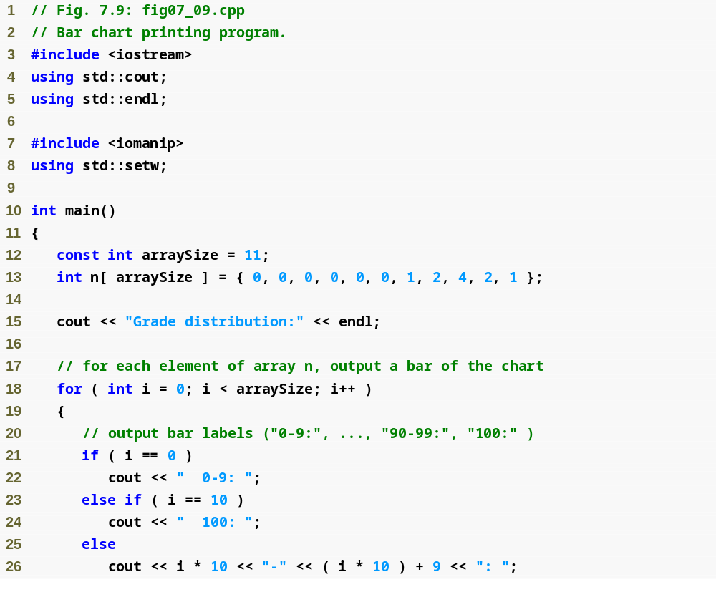
Outline
fig07_09.cpp
(1 of 2)
Declare array with initializer list

Slide 37
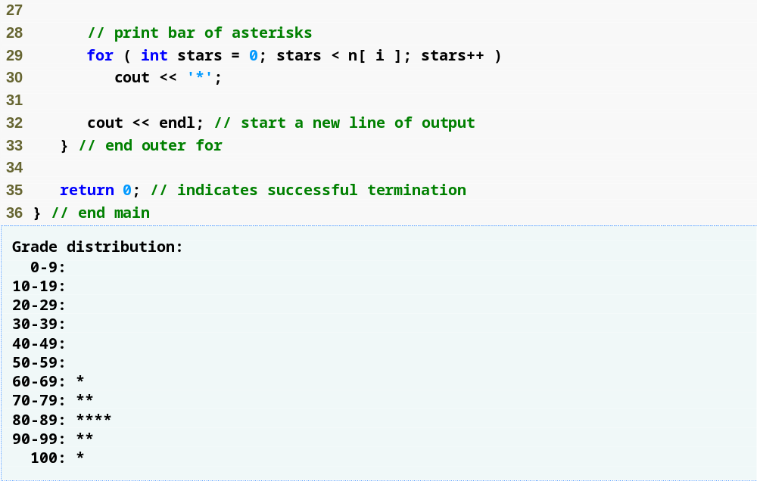
Outline
For each array element, print the associated number of asterisks
fig07_09.cpp
(2 of 2)

Slide 38
Common Programming Error 7.7
Although it is possible to use the same control variable in a for statement and a second for statement nested inside, this is confusing and can lead to logic errors.

Slide 39
7.4 Examples Using Arrays (Cont.)
Using the elements of an array as counters
  Use a series of counter variables to summarize data
  Counter variables make up an array
  Store frequency values

Slide 40
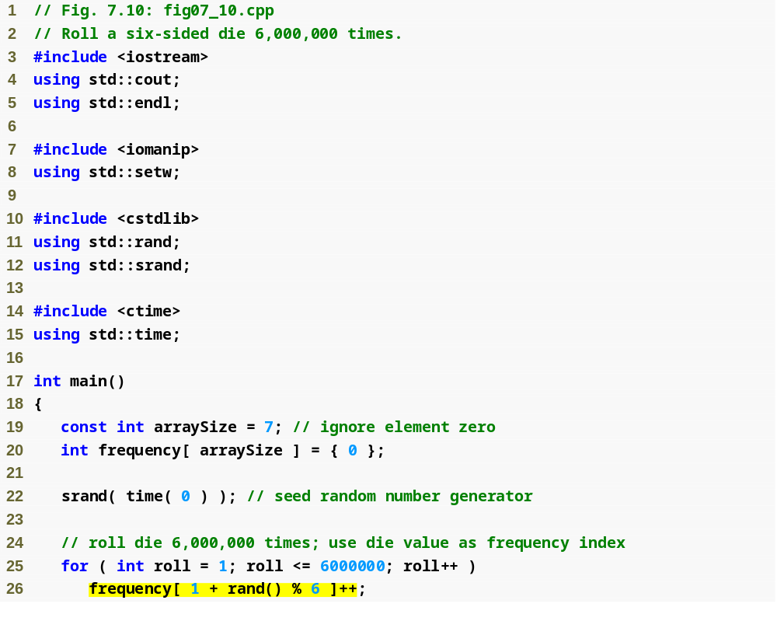
Outline
fig07_10.cpp
(1 of 2)
Declare frequency as array of 7 ints
Generate 6000000 random integers in range 1 to 6
Increment frequency values at the index associated with the random number

Slide 41
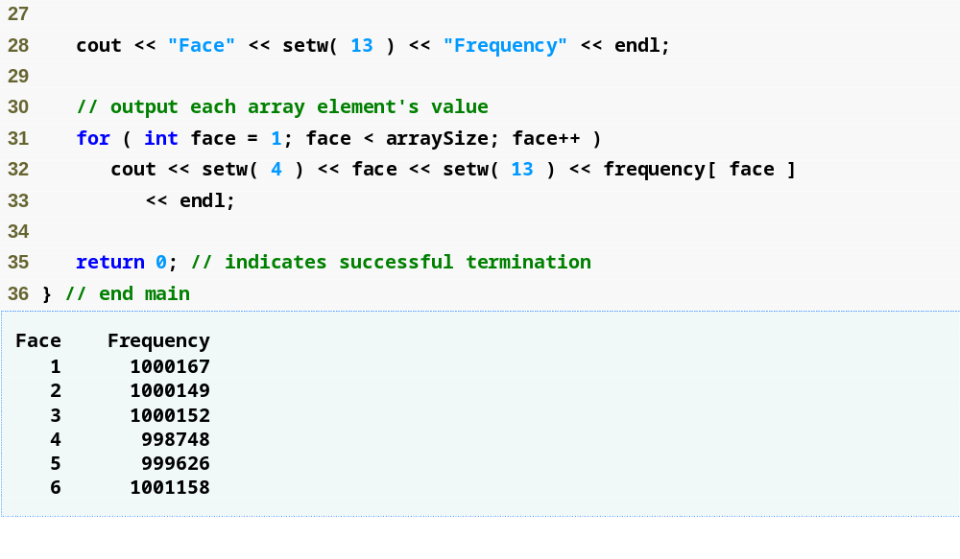
Outline
fig07_10.cpp
(2 of 2)

Slide 42
7.4 Examples Using Arrays (Cont.)
Using arrays to summarize survey results
  40 students rate the quality of food
    1-10 rating scale: 1 means awful, 10 means excellent
  Place 40 responses in an array of integers
  Summarize results
  Each element of the array used as a counter for one of the survey responses
C++ has no array bounds checking
  Does not prevent the computer from referring to an element that does not exist
    Could lead to serious execution-time errors

Slide 43
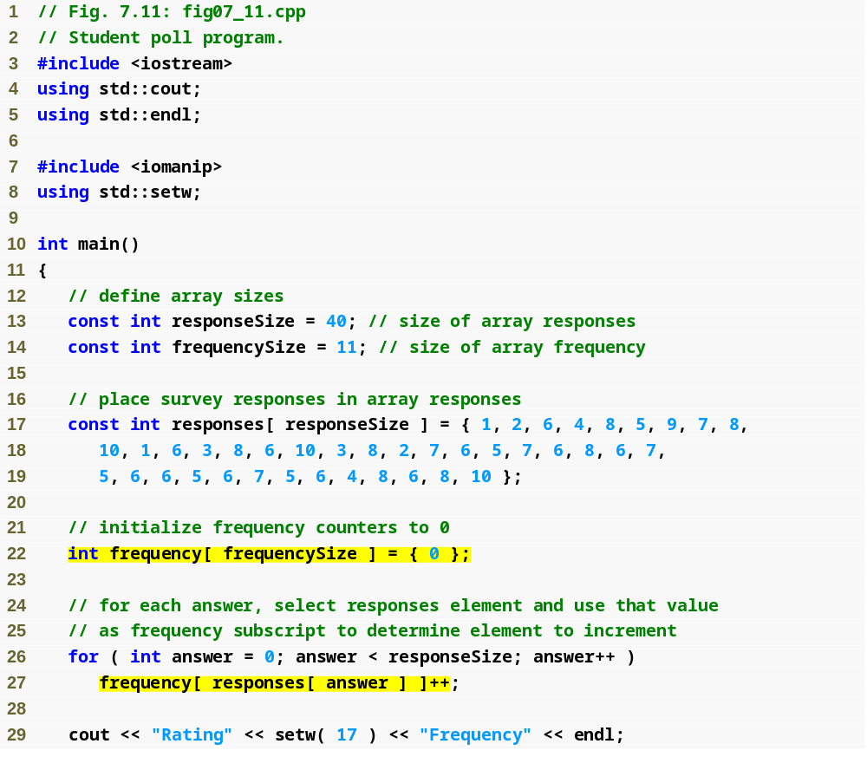
Outline
fig07_11.cpp
(1 of 2)
Array responses will store 40 responses
Array frequency will contain 11 ints (ignore the first element)
Initialize responses with 40 responses
Initialize frequency to all 0s
For each response, increment frequency value at the index associated with that response

Slide 44
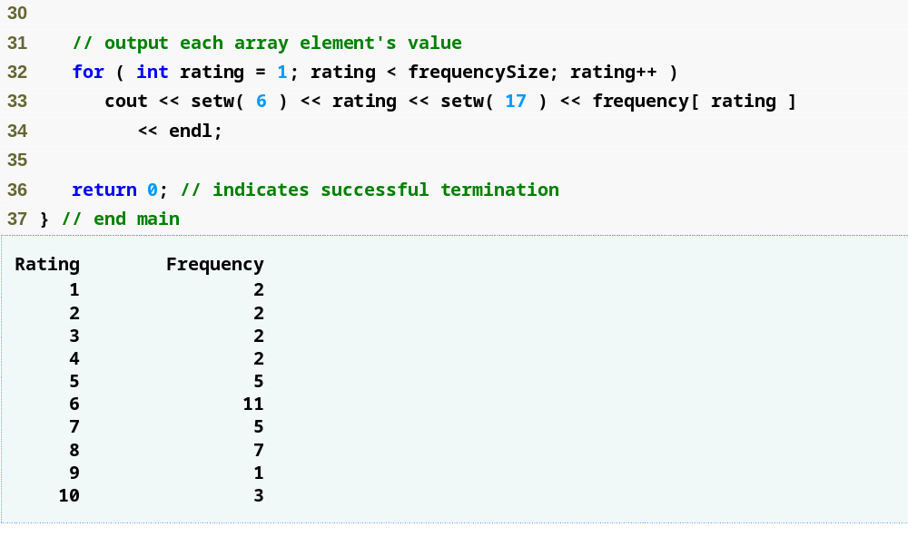
Outline
fig07_11.cpp
(2 of 2)

Slide 45
Software Engineering Observation 7.2
The const qualifier should be used to enforce the principle of least privilege. Using the principle of least privilege to properly design software can greatly reduce debugging time and improper side effects and can make a program easier to modify and maintain.

Slide 46
Good Programming Practice 7.3
Strive for program clarity. It is sometimes worthwhile to trade off the most efficient use of memory or processor time in favor of writing clearer programs.

Slide 47
Performance Tip 7.1
Sometimes performance considerations far outweigh clarity considerations.

Slide 48
Common Programming Error 7.8
Referring to an element outside the array bounds is an execution-time logic error. It is not a syntax error.

Slide 49
Error-Prevention Tip 7.1
When looping through an array, the array subscript should never go below 0 and should always be less than the total number of elements in the array (one less than the size of the array). Make sure that the loop-termination condition prevents accessing elements outside this range.

Slide 50
Portability Tip 7.1
The (normally serious) effects of referencing elements outside the array bounds are system dependent. Often this results in changes to the value of an unrelated variable or a fatal error that terminates program execution.

Slide 51
Error-Prevention Tip 7.2
In Chapter 11, we will see how to develop a class representing a “smart array,” which checks that all subscript references are in bounds at runtime. Using such smart data types helps eliminate bugs.

Slide 52
7.4 Examples Using Arrays (Cont.)
Using character arrays to store and manipulate strings
  Arrays may be of any type, including chars
    We can store character strings in char arrays
  Can be initialized using a string literal
    Example
      char string1[] = "Hi";
    Equivalent to
      char string1[] = { 'H', 'i', '\0' };
  Array contains each character plus a special string-termination character called the null character ('\0')

Slide 53
7.4 Examples Using Arrays (Cont.)
Using character arrays to store and manipulate strings (Cont.)
  Can also be initialized with individual character constants in an initializer list
  char string1[] =
  { 'f', 'i', 'r', 's', 't', '\0' };
  Can also input a string directly into a character array from the keyboard using cin and >>
  cin >> string1;
    cin >> may read more characters than the array can store
  A character array representing a null-terminated string can be output with cout and <<

Slide 54
Common Programming Error 7.9
Not providing cin >> with a character array large enough to store a string typed at the keyboard can result in loss of data in a program and other serious runtime errors.

Slide 55
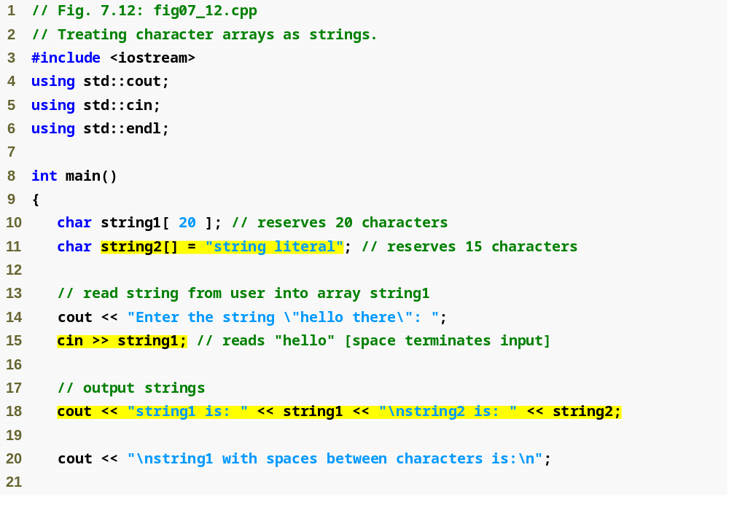
Outline
fig07_12.cpp
(1 of 2)
Store "string literal" as an array of characters
Initializing an array of characters using cin
Output array using cin

Slide 56
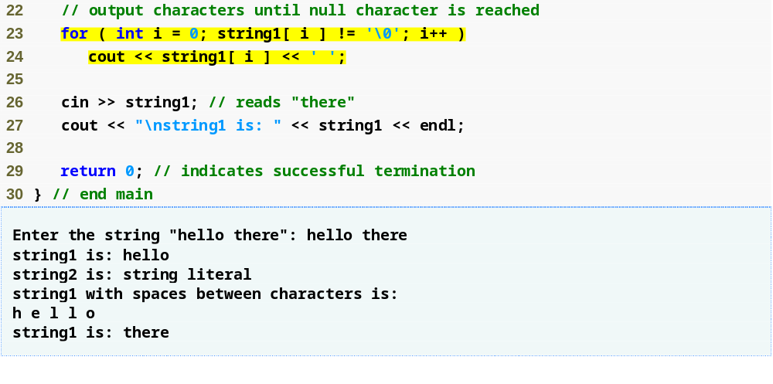
Outline
Loop until the terminating null character is reached
Accessing specific characters in the array
fig07_12.cpp
(2 of 2)

Slide 57
7.4 Examples Using Arrays (Cont.)
static local arrays and automatic local arrays
  A static local variable in a function
    Exists for the duration of the program
    But is visible only in the function body
  A static local array
    Exists for the duration of the program
    Is initialized when its declaration is first encountered
      All elements are initialized to zero if not explicitly initialized
        This does not happen for automatic local arrays

Slide 58
Performance Tip 7.2
We can apply static to a local array declaration so that the array is not created and initialized each time the program calls the function and is not destroyed each time the function terminates in the program. This can improve performance, especially when using large arrays.

Slide 59
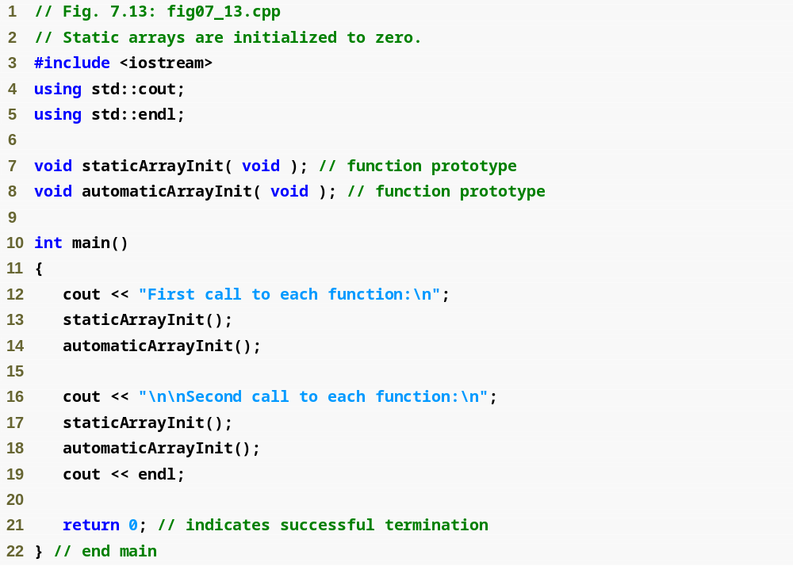
Outline
fig07_13.cpp
(1 of 3)

Slide 60
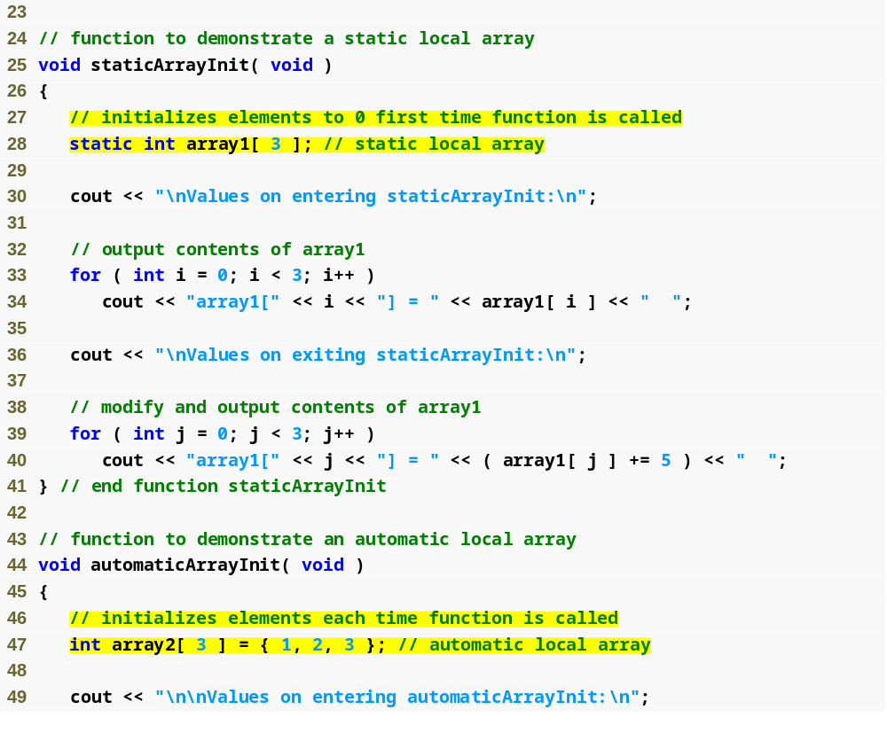
Outline
fig07_13.cpp
(2 of 3)
Create a static array using keyword static
Create an automatic local array

Slide 61
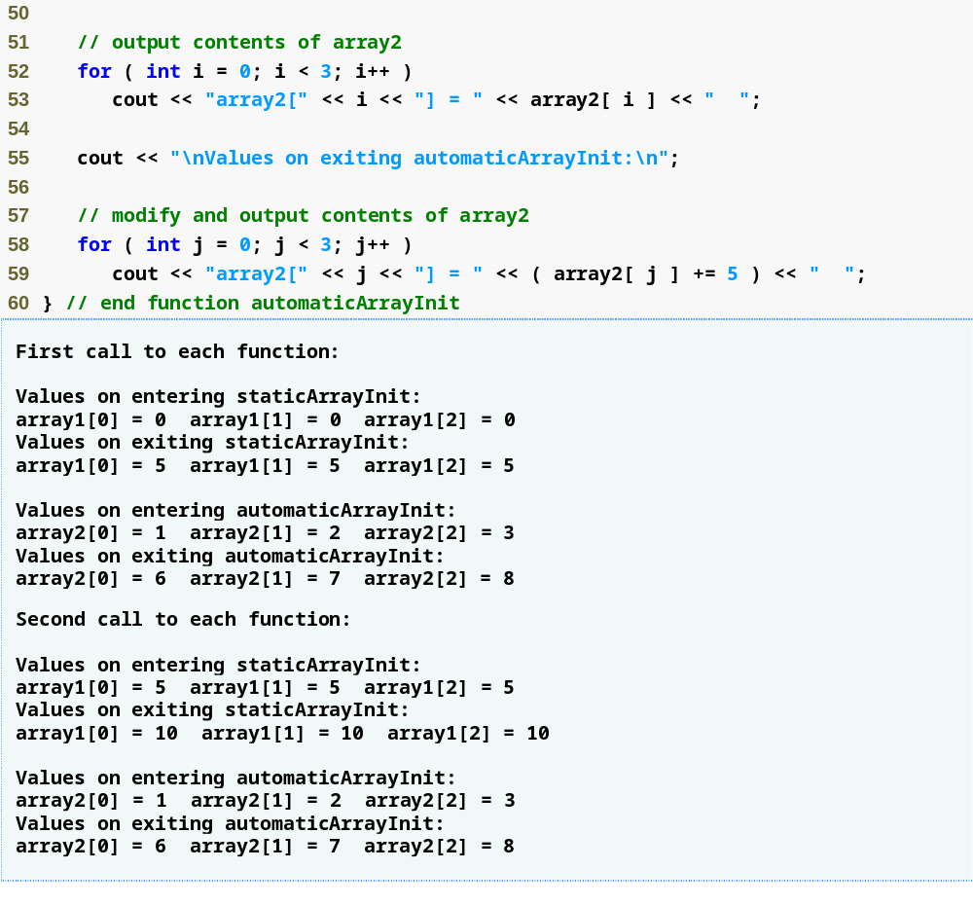
Outline
fig07_13.cpp
(3 of 3)
Values reflect changes from the previous function call – the array was not reinitialized

Slide 62
Common Programming Error 7.10
Assuming that elements of a function’s local static array are initialized every time the function is called can lead to logic errors in a program.

Slide 63
7.5 Passing Arrays to Functions
To pass an array argument to a function
  Specify array name without brackets
    Array hourlyTemperatures is declared as
    int hourlyTemperatures[ 24 ];
    The function call
    modifyArray( hourlyTemperatures, 24 );
    passes array hourlyTemperatures and its size to function modifyArray
  Array size is normally passed as another argument so the function can process the specific number of elements in the array

Slide 64
7.5 Passing Arrays to Functions (Cont.)
Arrays are passed by reference
  Function call actually passes starting address of array
    So function knows where array is located in memory
  Caller gives called function direct access to caller’s data
    Called function can manipulate this data

Slide 65
Performance Tip 7.3
Passing arrays by reference makes sense for performance reasons. If arrays were passed by value, a copy of each element would be passed. For large, frequently passed arrays, this would be time consuming and would require considerable storage for the copies of the array elements.

Slide 66
Software Engineering Observation 7.3
It is possible to pass an array by value (by using a simple trick we explain in Chapter 22)—this is rarely done.

Slide 67
7.5 Passing Arrays to Functions (Cont.)
Individual array elements passed by value
  Single pieces of data
    Known as scalars or scalar quantities
  To pass an element to a function
    Use the subscripted name of the array element as an argument
Functions that take arrays as arguments
  Function parameter list must specify array parameter
    Example
      void modArray( int b[], int arraySize );

Slide 68
7.5 Passing Arrays to Functions (Cont.)
Functions that take arrays as arguments (Cont.)
  Array parameter may include the size of the array
    Compiler will ignore it, though
      Compiler only cares about the address of the first element
Function prototypes may include parameter names
  But the compiler will ignore them
  Parameter names may be left out of function prototypes

Slide 69
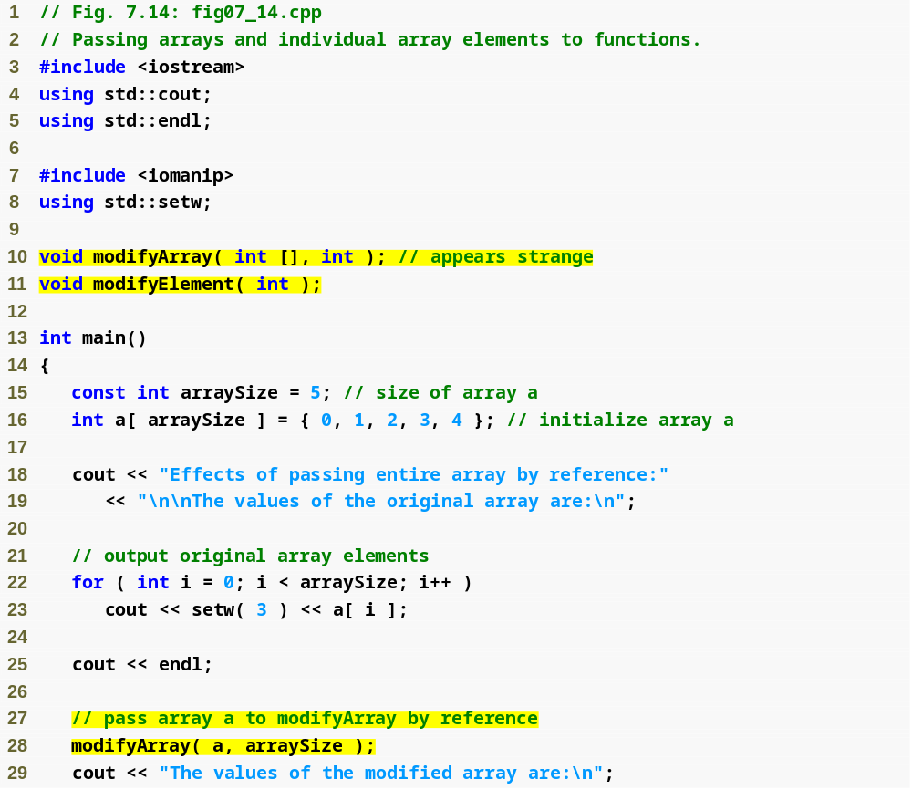
Outline
Function takes an array as argument
fig07_14.cpp
(1 of 3)
Declare 5-int array array with initializer list
Pass entire array to function modifyArray

Slide 70
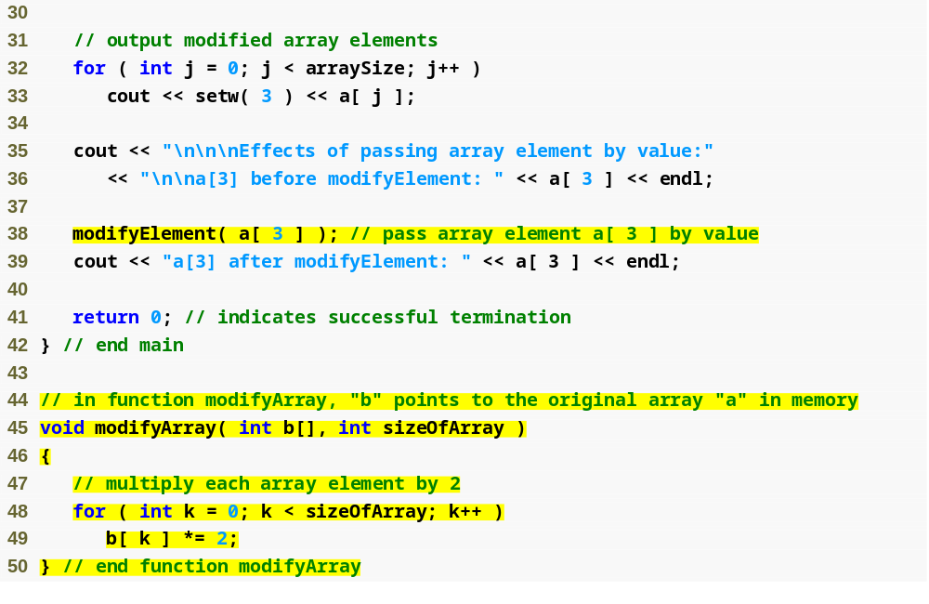
Outline
Pass array element a[ 3 ] to function modifyElement
fig07_14.cpp
(2 of 3)
Function modifyArray manipulates the array directly

Slide 71
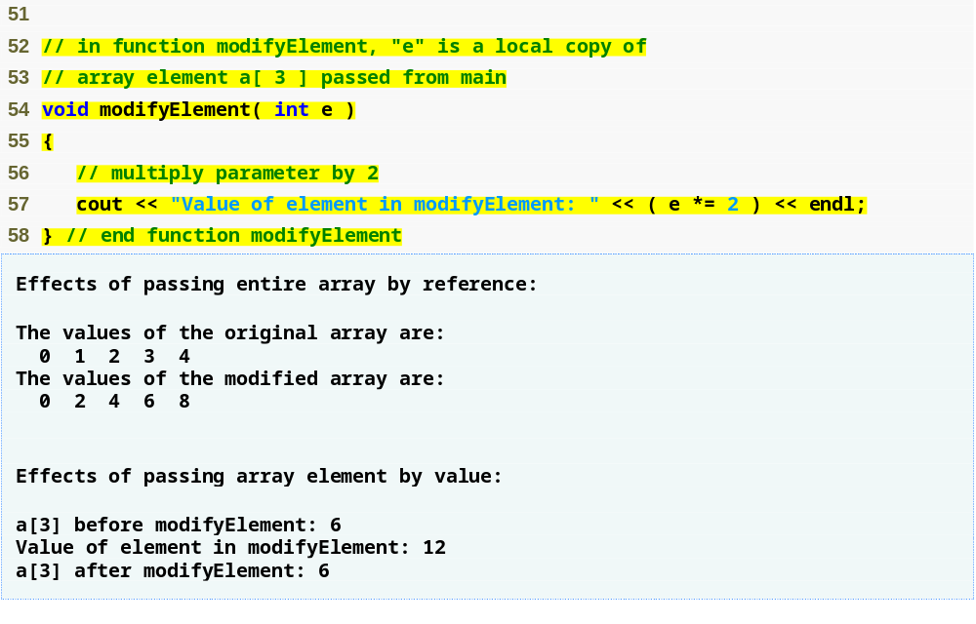
Outline
Function modifyElement manipulates array element’s copy
fig07_14.cpp
(3 of 3)

Slide 72
7.5 Passing Arrays to Functions (Cont.)
const array parameters
  Qualifier const
  Prevent modification of array values in the caller by code in the called function
  Elements in the array are constant in the function body
  Enables programmer to prevent accidental modification of data

Slide 73
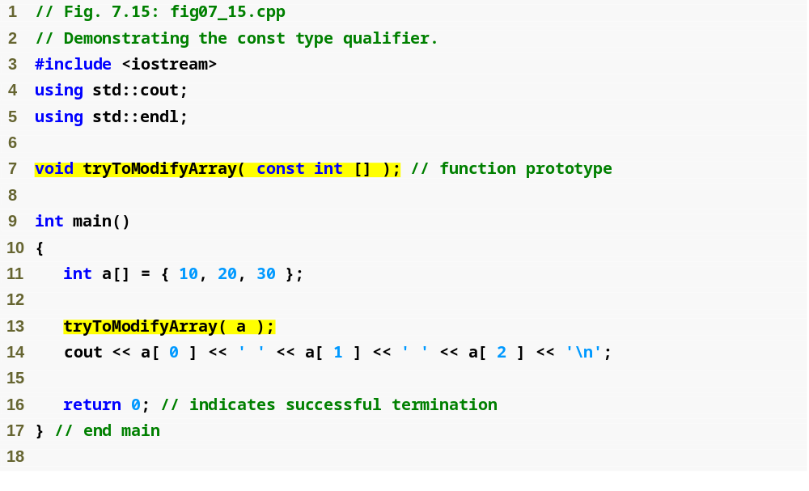
Outline
Using const to prevent the function from modifying the array
fig07_15.cpp
(1 of 2)
Array a will be const when in the body of the function

Slide 74
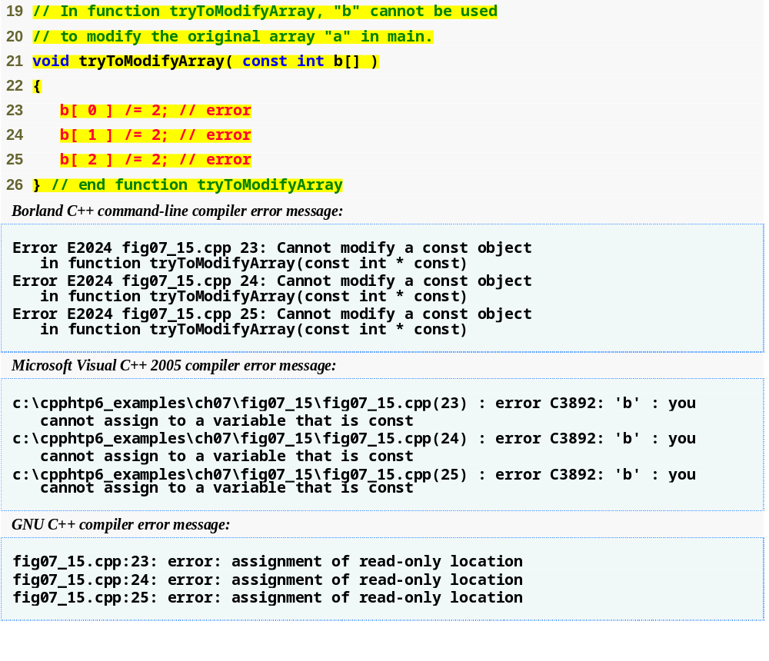
Outline
Array cannot be modified; it is const within the body function
fig07_15.cpp
(2 of 2)

Slide 75
Common Programming Error 7.11
Forgetting that arrays in the caller are passed by reference, and hence can be modified in called functions, may result in logic errors.

Slide 76
Software Engineering Observation 7.4
Applying the const type qualifier to an array parameter in a function definition to prevent the original array from being modified in the function body is another example of the principle of least privilege. Functions should not be given the capability to modify an array unless it is absolutely necessary.

Slide 77
7.6 Case Study: Class GradeBook Using an Array to Store Grades
Class GradeBook
  Represent a grade book that stores and analyzes grades
  Can now store grades in an array
static data members
  Also called class variables
  Variables for which each object of a class does not have a separate copy
    One copy is shared among all objects of the class
  Can be accessed even when no objects of the class exist
    Use the class name followed by the binary scope resolution operator and the name of the static data member

Slide 78
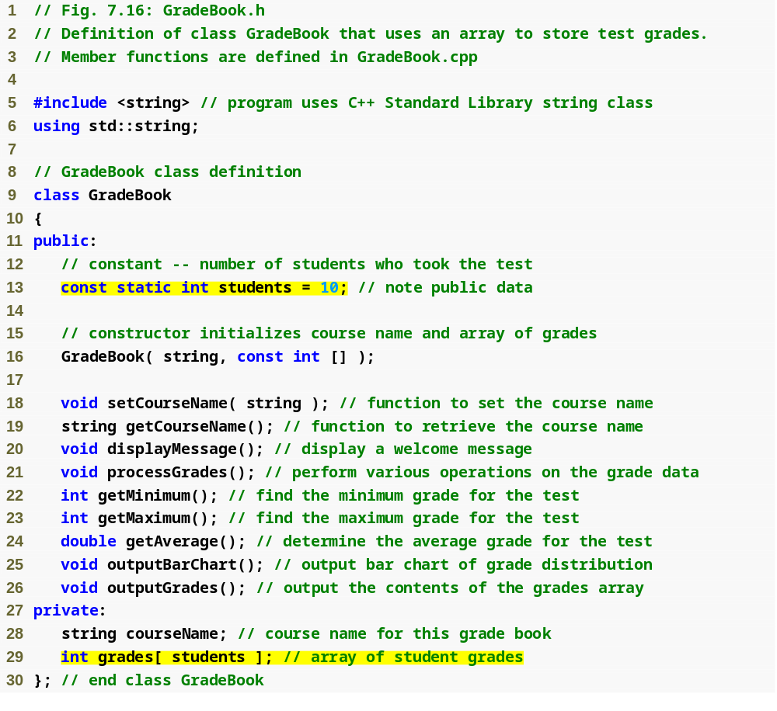
Outline
students is a static class variable
fig07_16.cpp
(1 of 1)
Number of students we will be keeping track of
Declare array grades to store individual grades

Slide 79
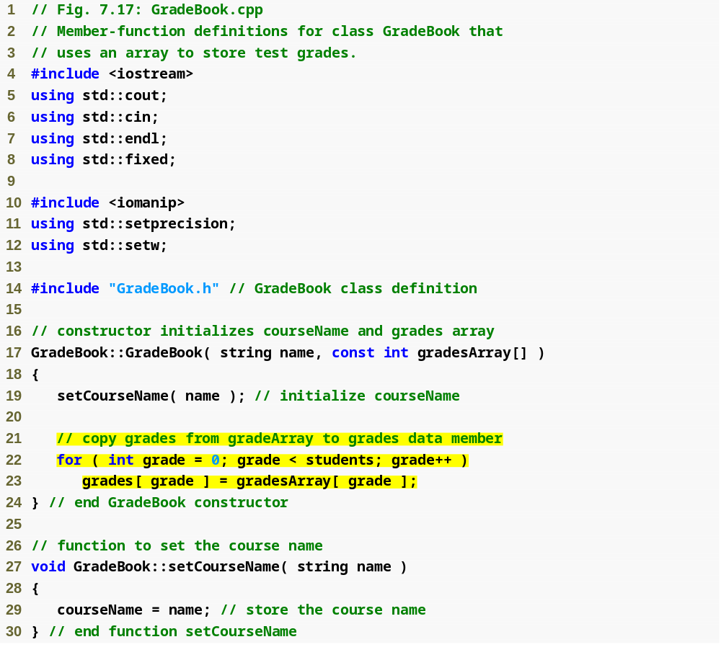
Outline
fig07_17.cpp
(1 of 6)
Copy elements from gradesArray to data member grades

Slide 80
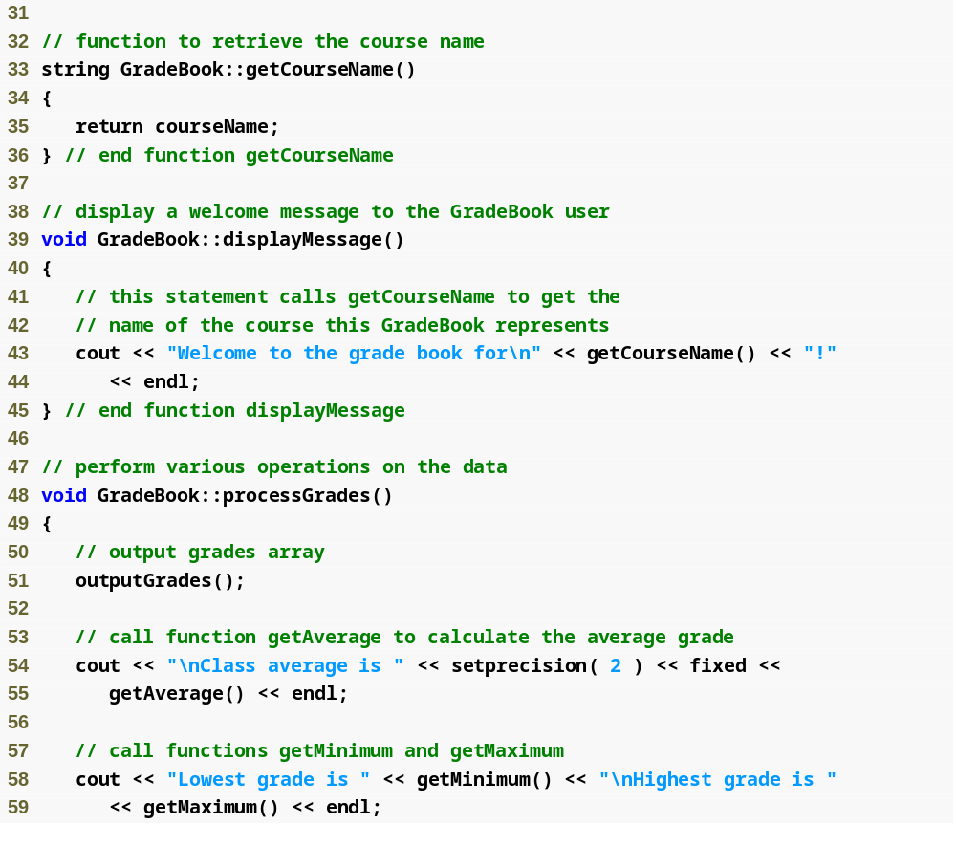
Outline
fig07_17.cpp
(2 of 6)

Slide 81
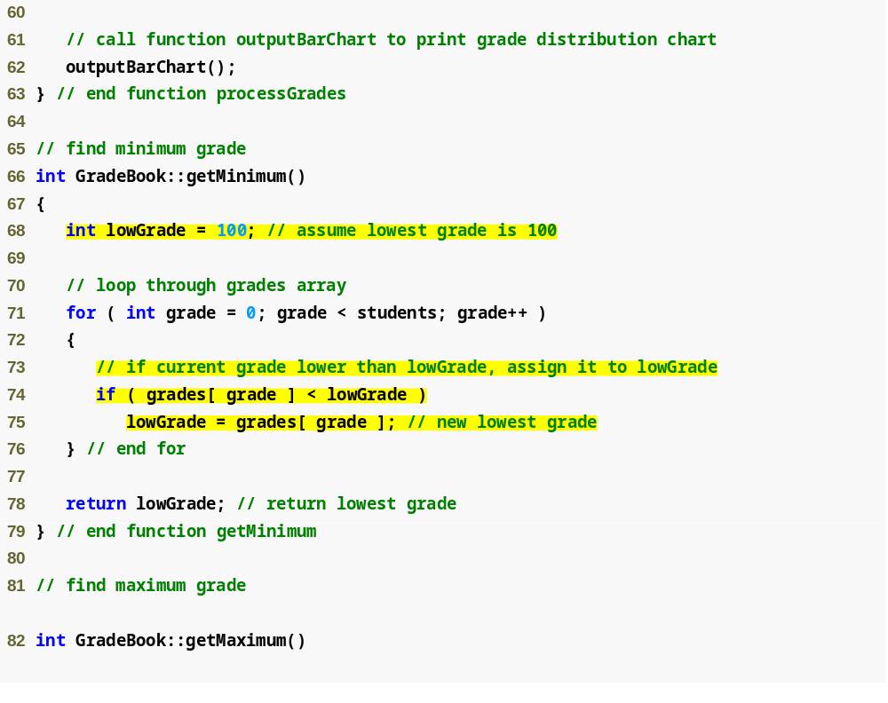
Outline
fig07_17.cpp
(3 of 6)
Loop through grades to find the lowest grade

Slide 82
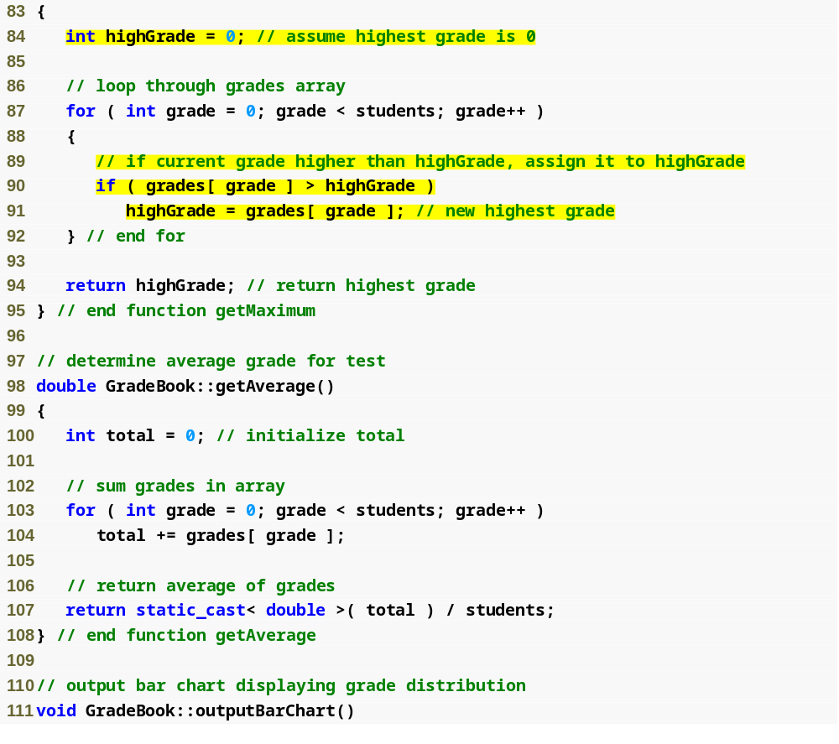
Outline
Loop through grades to find the highest grade
fig07_17.cpp
(4 of 6)
Loop through grades to sum grades for all students
Divide the total by the number of students to calculate the average grade

Slide 83
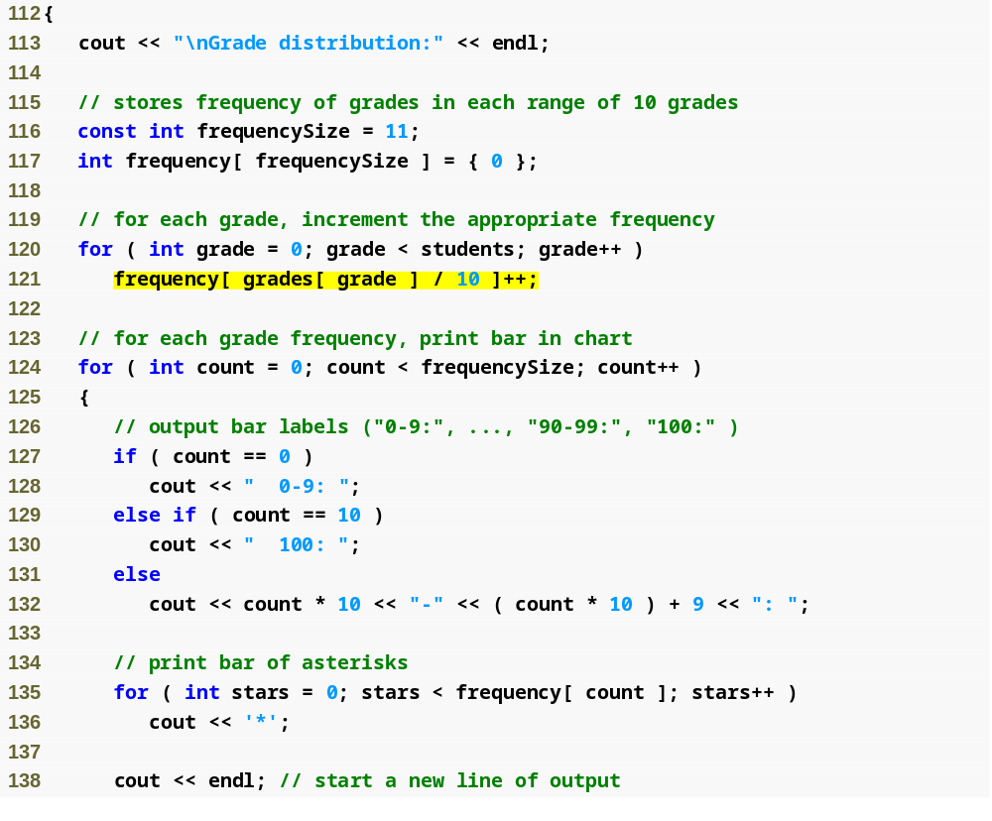
Outline
fig07_17.cpp
(5 of 6)
Loop through grades to calculate frequency
Display asterisks to show a bar for each grade range

Slide 84
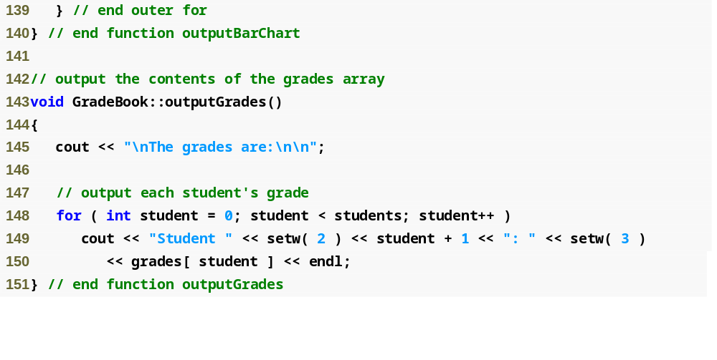
Outline
fig07_17.cpp
(6 of 6)
Displaying each grade

Slide 85
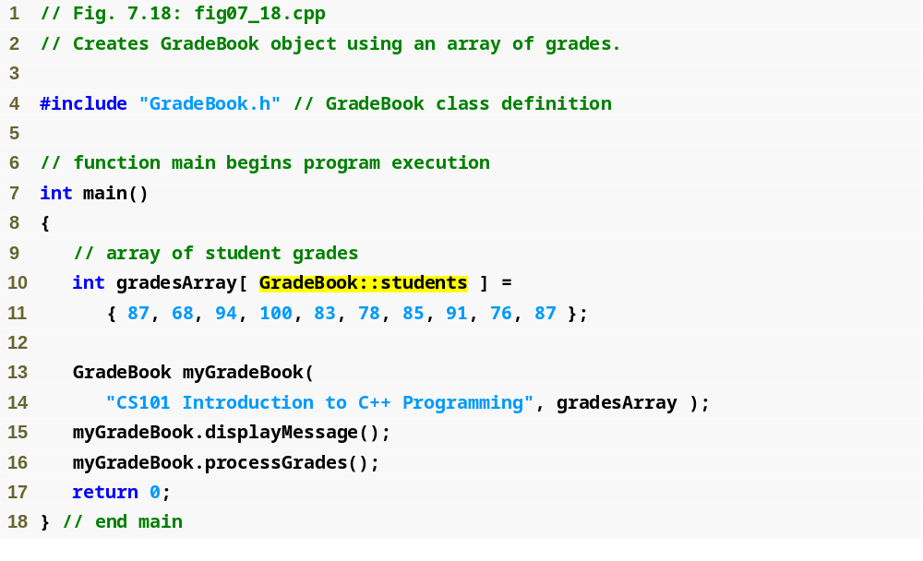
Outline
Use static data member students of class GradeBook
fig07_18.cpp
(1 of 2)
Declare and initialize gradesArray with 10 elements
Pass gradesArray to GradeBook constructor

Slide 86
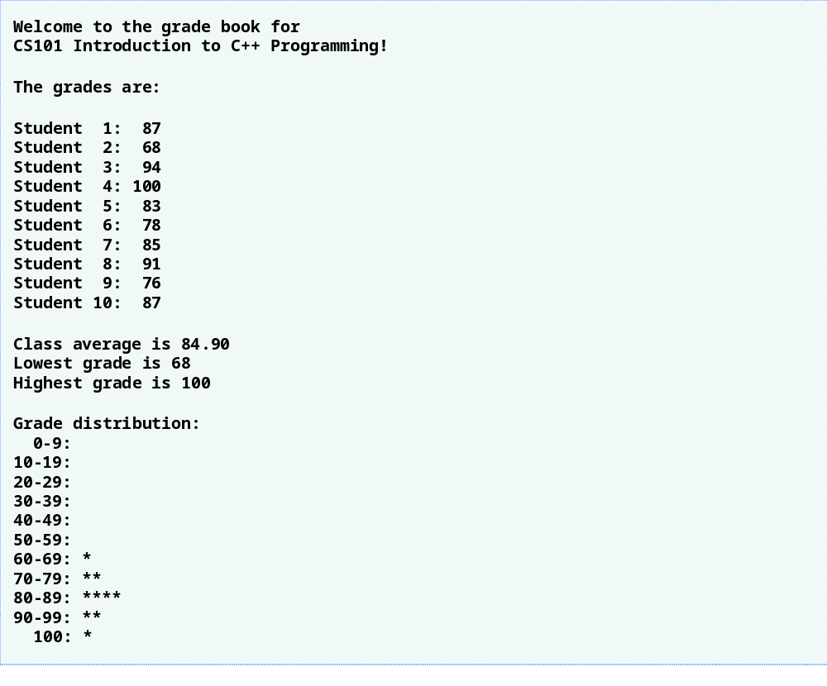
Outline
fig07_18.cpp
(2 of 2)

Slide 87
7.7 Searching Arrays with Linear Search
Arrays may store large amounts of data
  May need to determine if certain key value is located in an array
Linear search
  Compares each element of an array with a search key
  Just as likely that the value will be found in the first element as the last
    On average, program must compare the search key with half the elements of the array
  To determine that value is not in array, program must compare the search key to every element in the array
  Works well for small or unsorted arrays

Slide 88
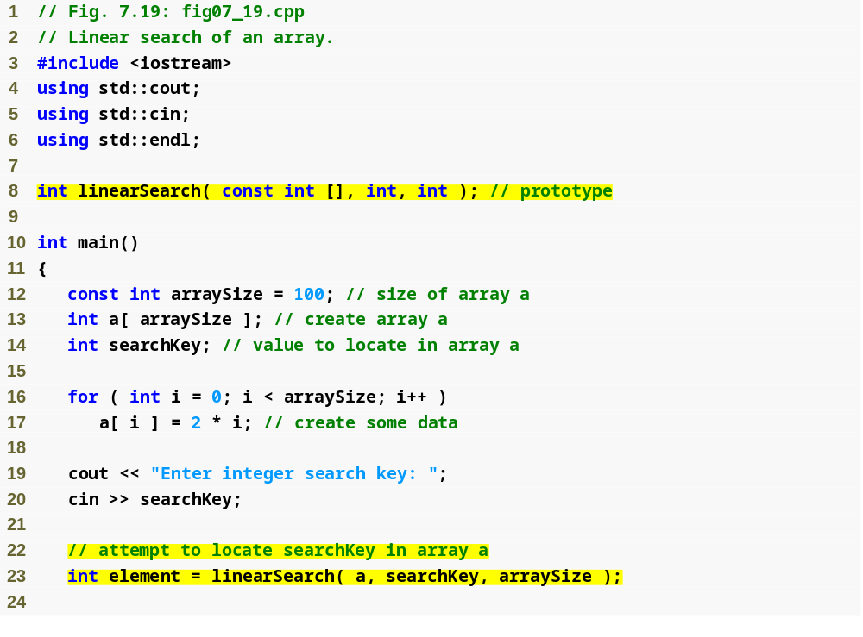
Outline
Function takes an array, a key value, and the size of the array as arguments
fig07_19.cpp
(1 of 2)
Function returns location of key value, -1 if not found

Slide 89
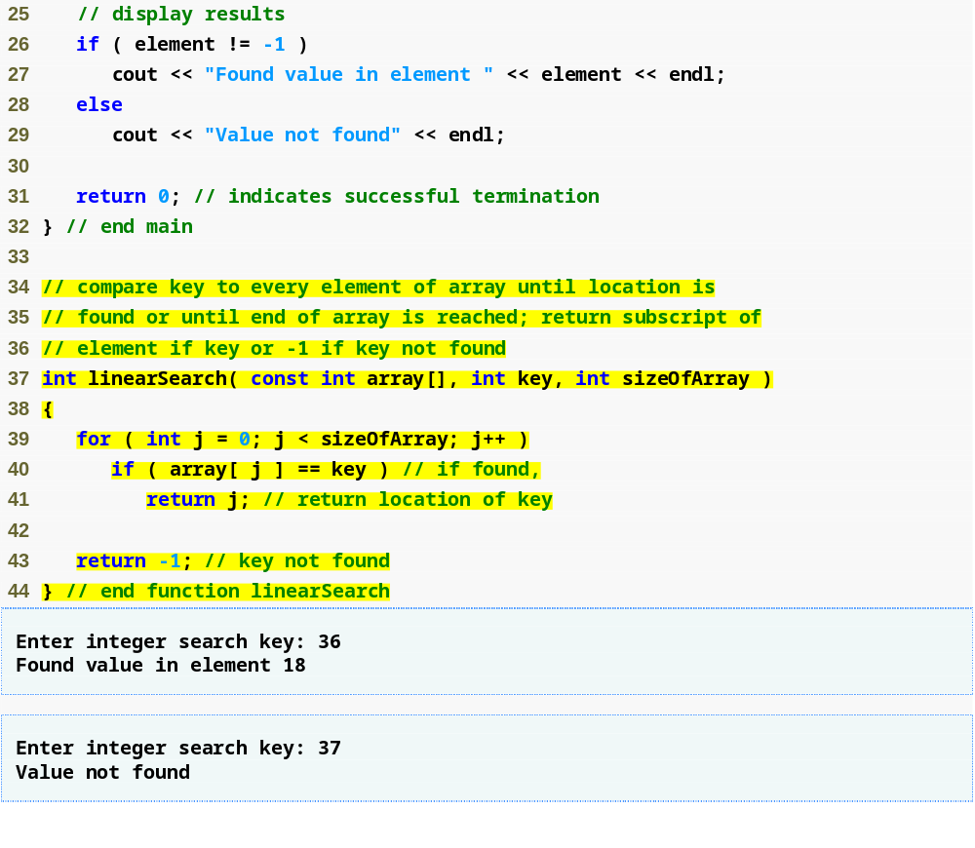
Outline
fig07_19.cpp
(2 of 2)
Search through entire array
Return location if current value equals key value

Slide 90
7.8 Sorting Arrays with Insertion Sort
Sorting data
  One of the most important computing applications
    Virtually every organization must sort some data
Insertion sort
  Simple but inefficient
  First iteration takes second element
    If it is less than the first element, swap it with first element
  Second iteration looks at the third element
    Insert it into the correct position with respect to first two elements
  …
  At the i^{th} iteration of this algorithm, the first i elements in the original array will be sorted

Slide 91
Performance Tip 7.4
Sometimes, simple algorithms perform poorly. Their virtue is that they are easy to write, test and debug. More complex algorithms are sometimes needed to realize optimal performance.

Slide 92
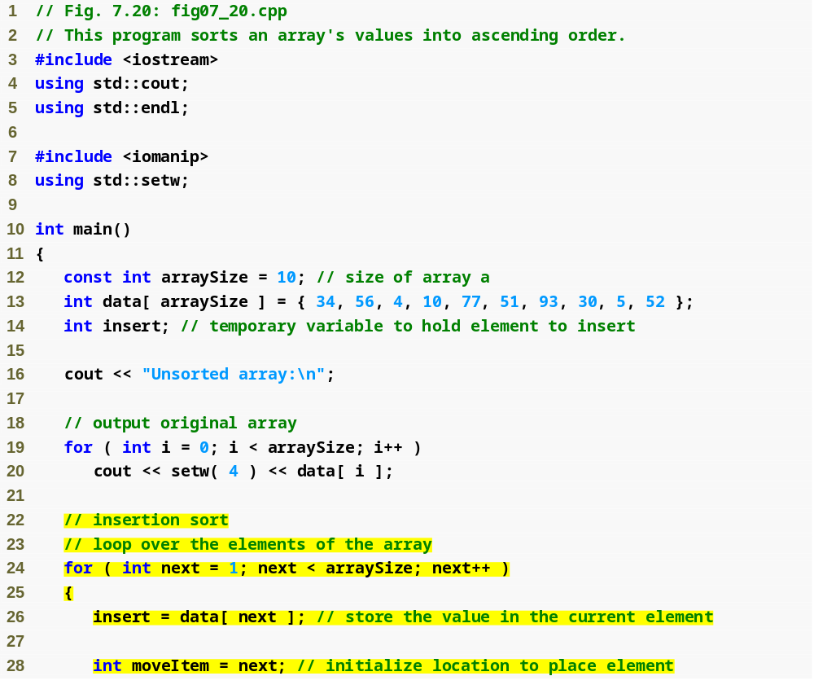
Outline
fig07_20.cpp
(1 of 2)
For each array element

Slide 93
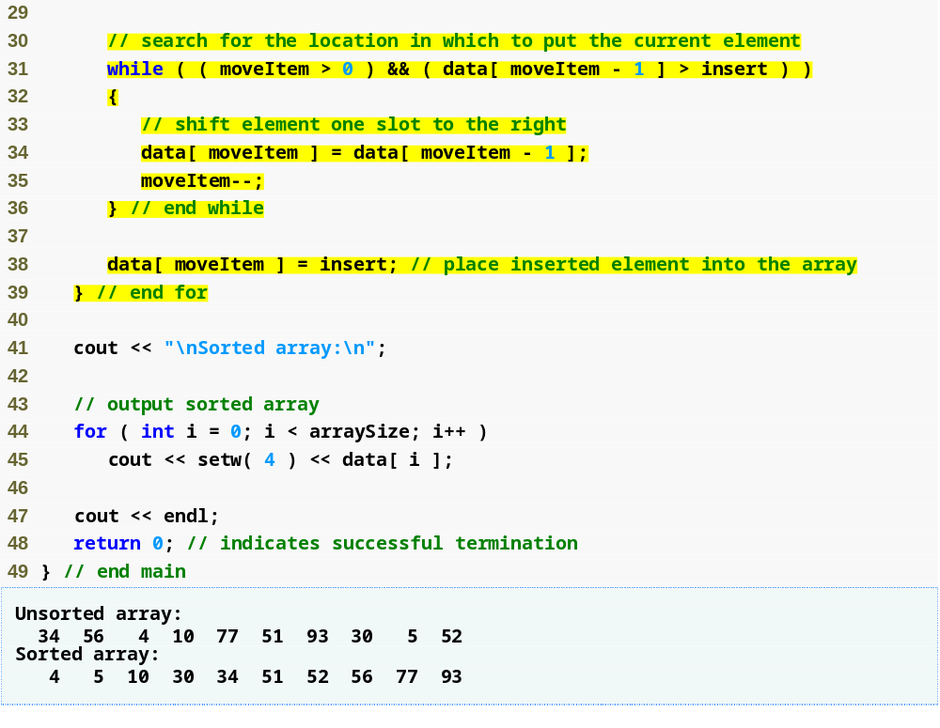
Outline
Find location where current element should reside
fig07_20.cpp
(2 of 2)
Place element in proper location

Slide 94
7.9 Multidimensional Arrays
Multidimensional arrays with two dimensions
  Called two dimensional or 2-D arrays
  Represent tables of values with rows and columns
  Elements referenced with two subscripts ([ x ][ y ])
  In general, an array with m rows and n columns is called an m-by-n array
Multidimensional arrays can have more than two dimensions

Slide 95
Common Programming Error 7.12
Referencing a two-dimensional array element a[ x ][ y ] incorrectly as a[ x, y ] is an error. Actually, a[ x, y ] is treated as a[ y ], because C++ evaluates the expression x, y (containing a comma operator) simply as y (the last of the comma-separated expressions).

Slide 96
7.9 Multidimensional Arrays (Cont.)
Declaring and initializing two-dimensional arrays
  Declaring two-dimensional array b
    int b[ 2 ][ 2 ] = { { 1, 2 }, { 3, 4 } };
      1 and 2 initialize b[ 0 ][ 0 ] and b[ 0 ][ 1 ]
      3 and 4 initialize b[ 1 ][ 0 ] and b[ 1 ][ 1 ]
    int b[ 2 ][ 2 ] = { { 1 }, { 3, 4 } };
      Row 0 contains values 1 and 0 (implicitly initialized to zero)
      Row 1 contains values 3 and 4

Slide 97
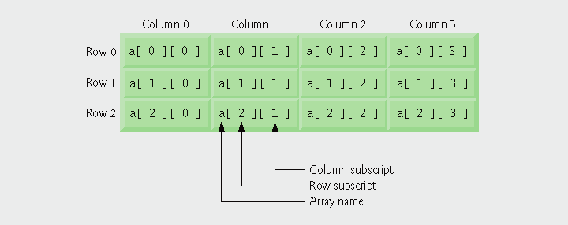
Fig.7.21 | Two-dimensional array with three rows and four columns.

Slide 98
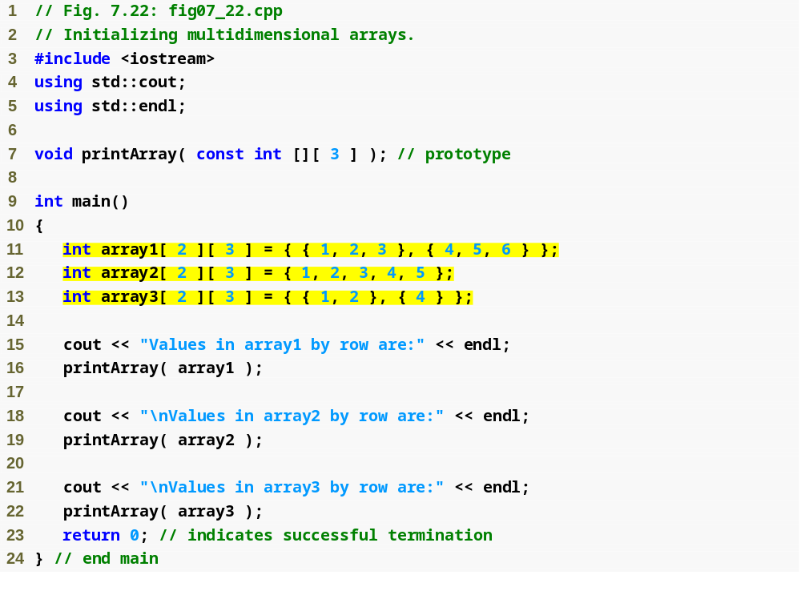
Outline
fig07_22.cpp
(1 of 2)
Use nested array initializers to initialize arrays

Slide 99
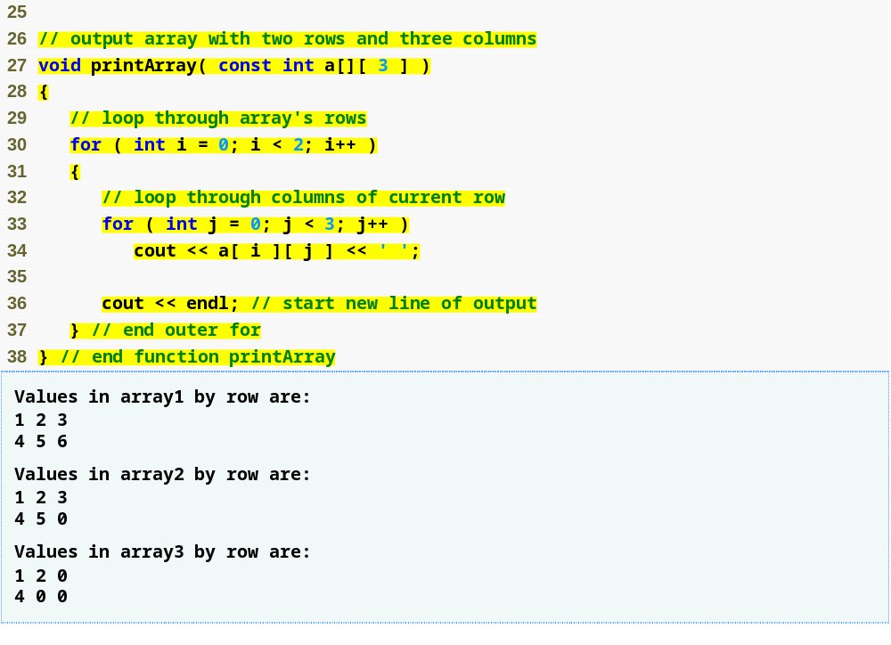
Outline
fig07_22.cpp
(2 of 2)
Use nested for loops to print array

Slide 100
7.9 Multidimensional Arrays (Cont.)
Multidimensional array parameters
  Size of first dimension is not required
    As with a one-dimensional array
  Size of subsequent dimensions are required
    Compiler must know how many elements to skip to move to the second element in the first dimension
  Example
    void printArray( const int a[][ 3 ] );
      Function will skip row 0’s 3 elements to access row 1’s elements (a[ 1 ][ x ])

Slide 101
7.9 Multidimensional Array (Cont.)
Multidimensional-array manipulations
  Commonly performed with for statements
    Example
      Modify all elements in a row
        for ( int col = 0; col < 4; col++ )
        a[ 2 ][ col ] = 0;
    Example
      Total all elements
        total = 0;
        for ( row = 0; row < 3; row++ )
        for ( col = 0; col < 4; col++ )
        total += a[ row ][ col ];

Slide 102
7.10 Case Study: Class GradeBook Using a Two-Dimensional Array
Class GradeBook
  One-dimensional array
    Store student grades on a single exam
  Two-dimensional array
    Store multiple grades for a single student and multiple students for the class as a whole
      Each row represents a student’s grades
      Each column represents all the grades the students earned for one particular exam

Slide 103
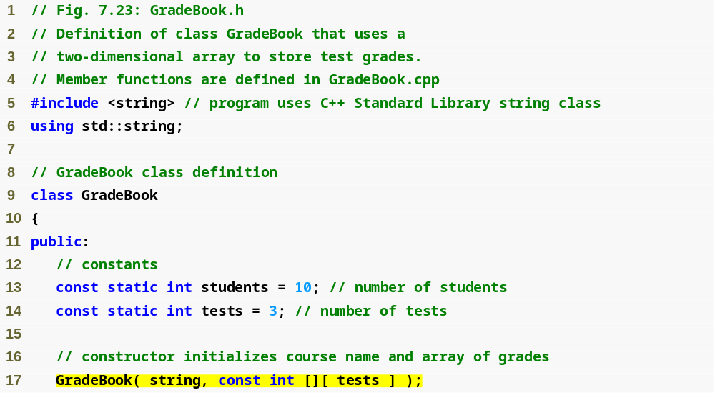
Outline
fig07_23.cpp
(1 of 2)
GradeBook constructor accepts a string and a two-dimensional array

Slide 104
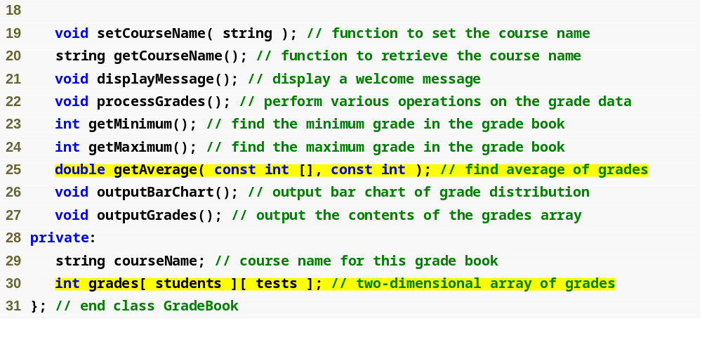
Outline
fig07_23.cpp
(2 of 2)
Declare two-dimensional array grades

Slide 105
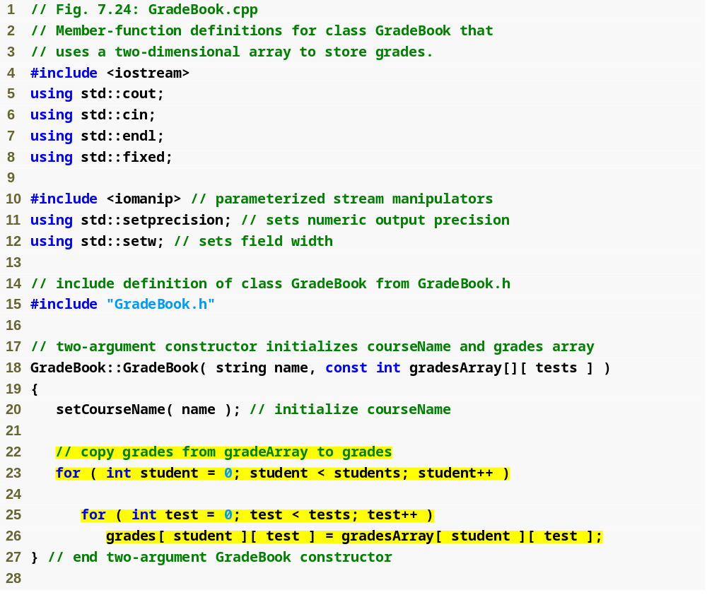
Outline
fig07_24.cpp
(1 of 7)
Use nested for loops to copy elements from gradesArray to grades

Slide 106
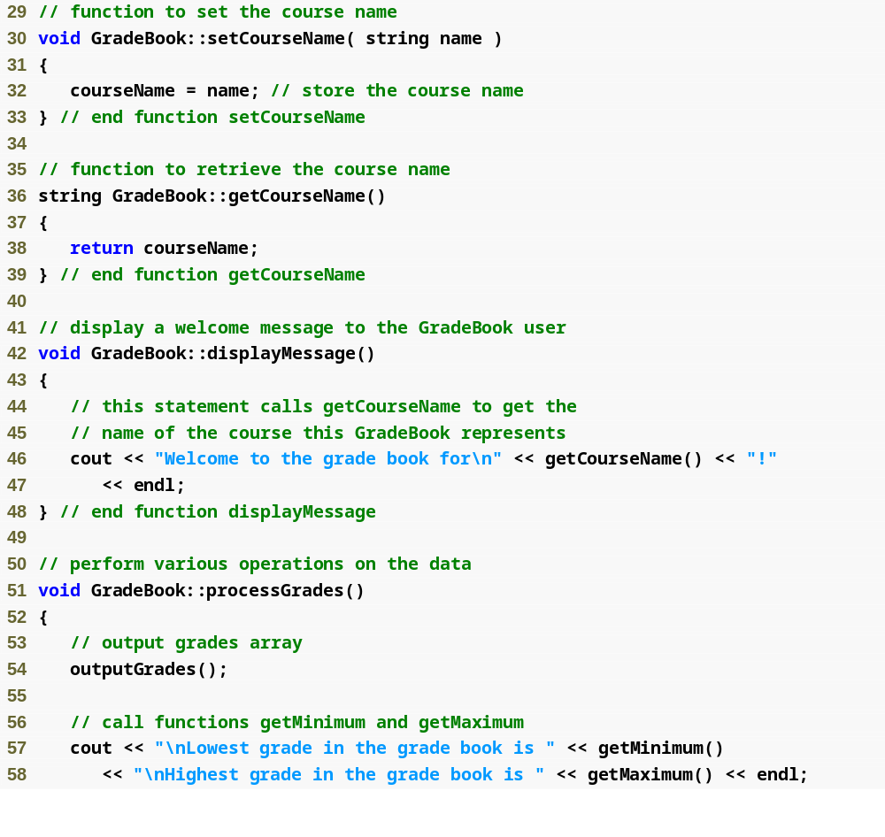
Outline
fig07_24.cpp
(2 of 7)

Slide 107
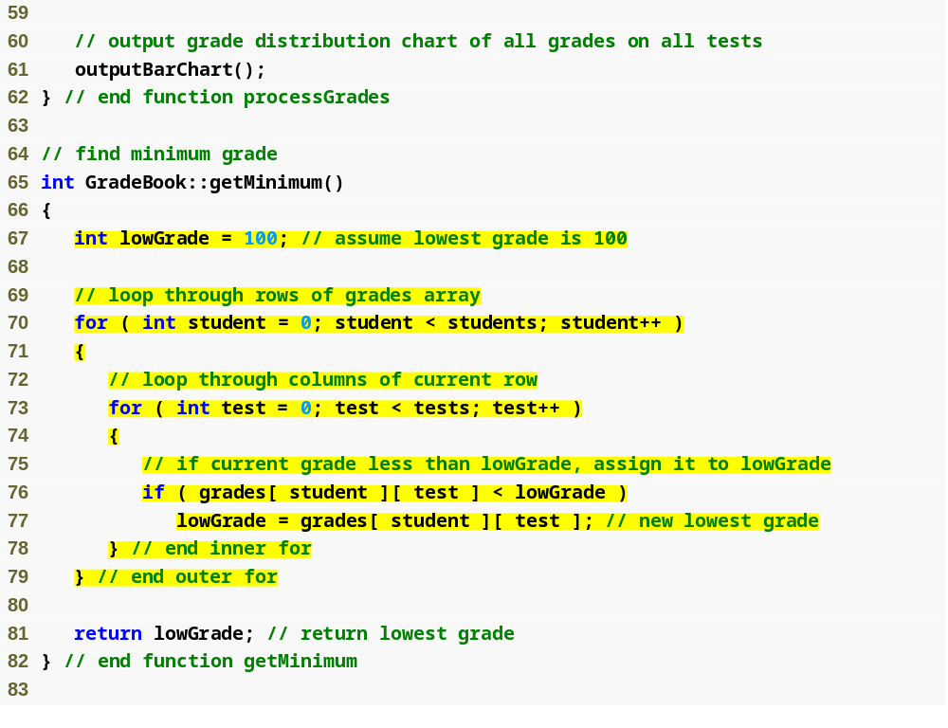
Outline
fig07_24.cpp
(3 of 7)
Loop through rows and columns of grades to find the lowest grade of any student

Slide 108
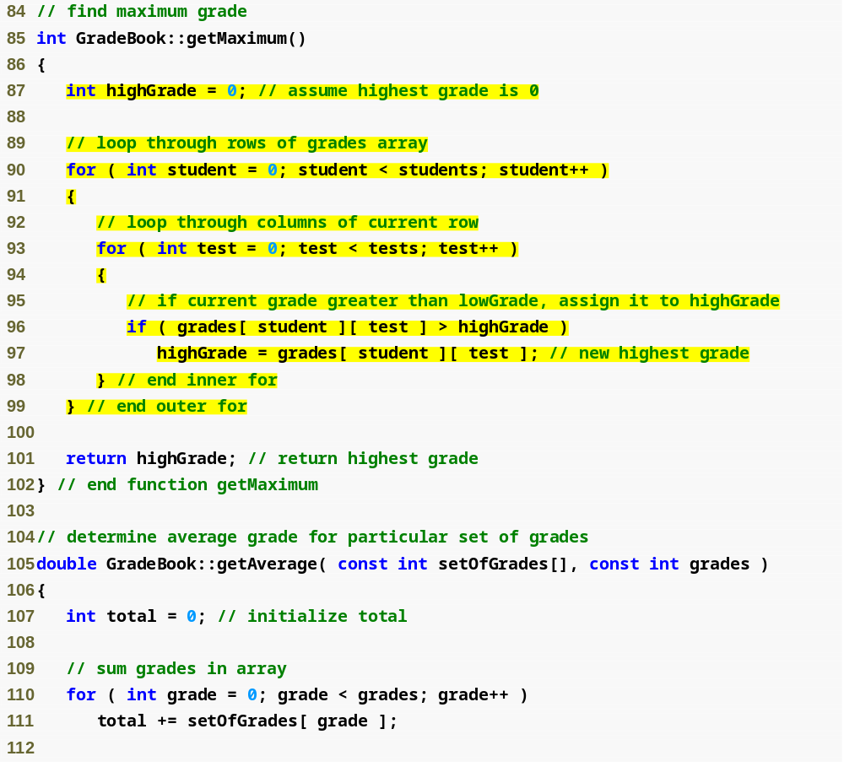
Outline
fig07_24.cpp
(4 of 7)
Loop through rows and columns of grades to find the highest grade of any student

Slide 109
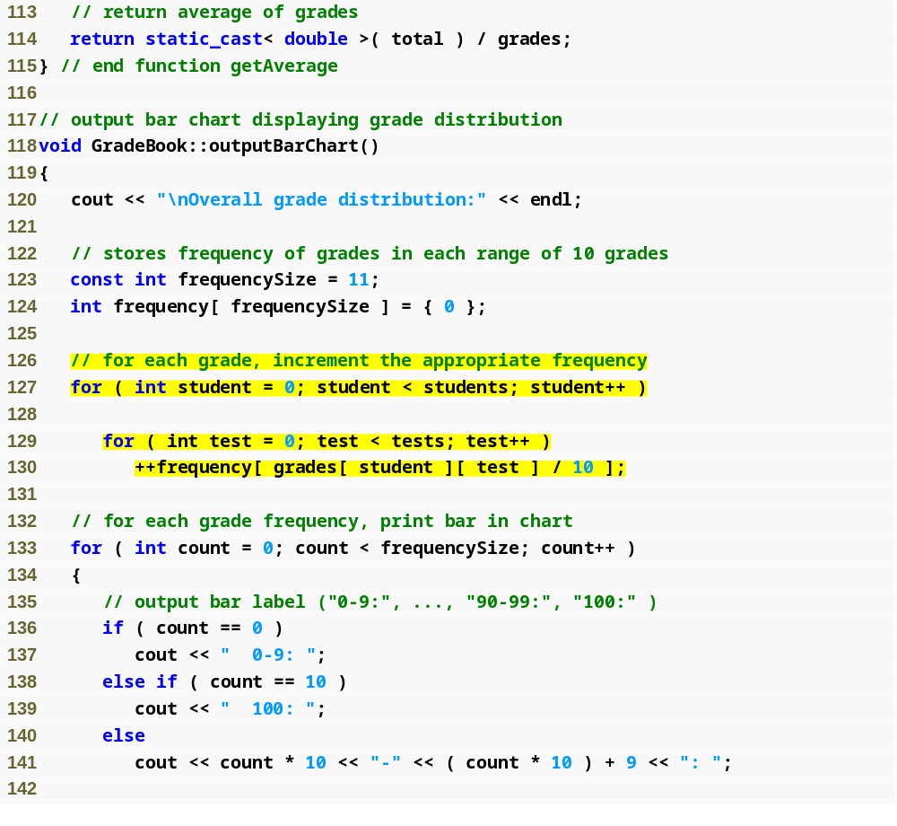
Outline
fig07_24.cpp
(5 of 7)
Calculate the distribution of all student grades

Slide 110

Outline
fig07_24.cpp
(6 of 7)

Slide 111

Outline
fig07_24.cpp
(7 of 7)

Slide 112

Outline
Declare gradesArray as 3-by-10 array
fig07_25.cpp
(1 of 2)
Each row represents a student; each column represents an exam grade

Slide 113

Outline
fig07_25.cpp
(2 of 2)

Slide 114
7.11 Introduction to C++ Standard Library Class Template vector
C-style pointer-based arrays
  Have great potential for errors and several shortcomings
    C++ does not check whether subscripts fall outside the range of the array
    Two arrays cannot be meaningfully compared with equality or relational operators
    One array cannot be assigned to another using the assignment operators

Slide 115
7.11 Introduction to C++ Standard Library Class Template vector (Cont.)
Class template vector
  Available to anyone building applications with C++
  Can be defined to store any data type
    Specified between angle brackets in vector< type >
    All elements in a vector are set to 0 by default
  Member function size obtains size of array
    Number of elements as a value of type size_t
  vector objects can be compared using equality and relational operators
  Assignment operator can be used for assigning vectors

Slide 116
7.11 Introduction to C++ Standard Library Class Template vector (Cont.)
vector elements can be obtained as an unmodifiable lvalue or as a modifiable lvalue
  Unmodifiable lvalue
    Expression that identifies an object in memory, but cannot be used to modify that object
  Modifiable lvalue
    Expression that identifies an object in memory, can be used to modify the object

Slide 117
7.11 Introduction to C++ Standard Library Class Template vector (Cont.)
vector member function at
  Provides access to individual elements
  Performs bounds checking
    Throws an exception when specified index is invalid
    Accessing with square brackets does not perform bounds checking

Slide 118

Outline
Using const prevents outputVector from modifying the vector passed to it
fig07_26.cpp
(1 of 6)
These vectors will store ints
Function size returns number of elements in the vector

Slide 119

Outline
fig07_26.cpp
(2 of 6)
Comparing vectors using !=
Copying data from one vector to another
Assigning data from one vector to another

Slide 120

Outline
fig07_26.cpp
(3 of 6)
Comparing vectors using ==
Displaying a value in the vector
Updating a value in the vector
Function at provides bounds checking

Slide 121

Outline
fig07_26.cpp
(4 of 6)
Display each vector element
Input vector values using cin

Slide 122

Outline
fig07_26.cpp
(5 of 6)

Slide 123

Outline
fig07_26.cpp
(6 of 6)
Call to function at with an invalid subscript terminates the program

Slide 124
7.12 (Optional) Software Engineering Case Study: Collaboration Among Objects in the ATM System
Collaborations
  When objects communicate to accomplish task
    One object sends a message to another object
    Accomplished by invoking operations (functions)
  Identifying the collaborations in a system
    Read requirements document to find
      What ATM should do to authenticate a user
      What ATM should do to perform transactions
    For each action, decide
      Which objects must interact
        Sending object
        Receiving object

Slide 125

Fig.7.27 | Collaborations in the ATM system.

Slide 126
7.12 (Optional) Software Engineering Case Study: Collaboration Among Objects in the ATM System (Cont.)
Interaction Diagrams
  Model interactions using UML
  Communication diagrams
    Also called collaboration diagrams
    Emphasize which objects participate in collaborations
  Sequence diagrams
    Emphasize when messages are sent between objects

Slide 127
7.12 (Optional) Software Engineering Case Study: Collaboration Among Objects in the ATM System (Cont.)
Communication diagrams
  Objects
    Modeled as rectangles
    Contain names in the form objectName : className
  Objects are connected with solid lines

Slide 128
7.12 (Optional) Software Engineering Case Study: Collaboration Among Objects in the ATM System (Cont.)
Communication diagrams (Cont.)
  Messages are passed along these lines in the direction shown by arrows
    Synchronous calls – solid arrowhead
      Sending object may not proceed until control is returned from the receiving object
    Asynchronous calls – stick arrowhead
      Sending object does not have to wait for the receiving object
    Name of message appears next to the arrow

Slide 129

Fig.7.28 | Communication diagram of the ATM executing a balance inquiry.

Slide 130
7.12 (Optional) Software Engineering Case Study: Collaboration Among Objects in the ATM System (Cont.)
Communication diagrams (Cont.)
  Sequence of messages in a communication diagram
    Indicated by the number to the left of a message name
    Indicate the order in which the messages are passed
    Process in numerical order from least to greatest
    Nested messages are indicated by decimal numbering
      Example
        First message nested in message 1 is message 1.1

Slide 131

Fig.7.29 | Communication diagram of the ATM executing a balance inquiry.

Slide 132
7.12 (Optional) Software Engineering Case Study: Collaboration Among Objects in the ATM System (Cont.)
Sequence diagrams
  Help model the timing of collaborations
  Lifeline
    Dotted line extending down from an object’s rectangle
      Represents the progression of time (top to bottom)
  Activation
    Thin vertical rectangle on an object’s lifeline
      Indicates that the object is executing

Slide 133
7.12 (Optional) Software Engineering Case Study: Collaboration Among Objects in the ATM System (Cont.)
Sequence diagrams (Cont.)
  Sending messages
    Similar to communication diagrams
    Solid arrow with filled arrowhead indicates a message
      Points to the beginning of an activation
    Dashed line with stick arrowhead indicates return of control
      Extends from the end of an activation

Slide 134

Fig.7.30 | Sequence diagram that models a Withdrawal executing.

Slide 135

Fig.7.31 | Sequence diagram that models a Deposit executing.

